Slide 1
Access Module 3a
Creating Query Object in
Design View
Microsoft Office 2016 Introductory

Slide 2
Student Learning Outcomes:
SLO#1: Importing data from an Excel file
and a Text file.
SLO#2: Create a Query in Design view.
SLO#3: Sort and Filter data in a datasheet.

Slide 3
Database Objects
Object | Description
Table | A collection of fields that describe a person, place, object, event, or idea. Formatted in a datasheet.
Query | Used to search and retrieve records from tables using criteria(s).

Slide 4
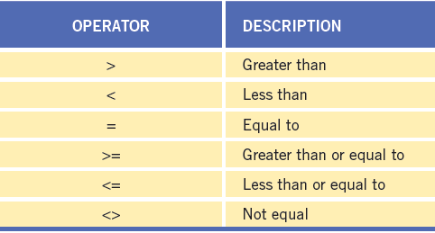
Using Relational Operators in a Criteria

Slide 5
Using Comparison Operators in a Criteria (page AC 142)
Operator | Meaning | Example
Between…And… | between two values (inclusive) | Between 50 And 325
In ( ) | in a list of values | In (“Hall”, “Seeger”)
Like | matches a pattern that includes *wildcards* | Like “706*”

Slide 6
Create a Query in Design View:
Step 1: Select Table to use.
Step 2: Select Fields.
Step 3: Enter Criteria(s).
Step 4: Run the Query.
Step 5: Check your Results.
Step 6: Save Query.

