Slide 1
Excel Module 1
Formatting Text and Data
Simple Calculations

Slide 2
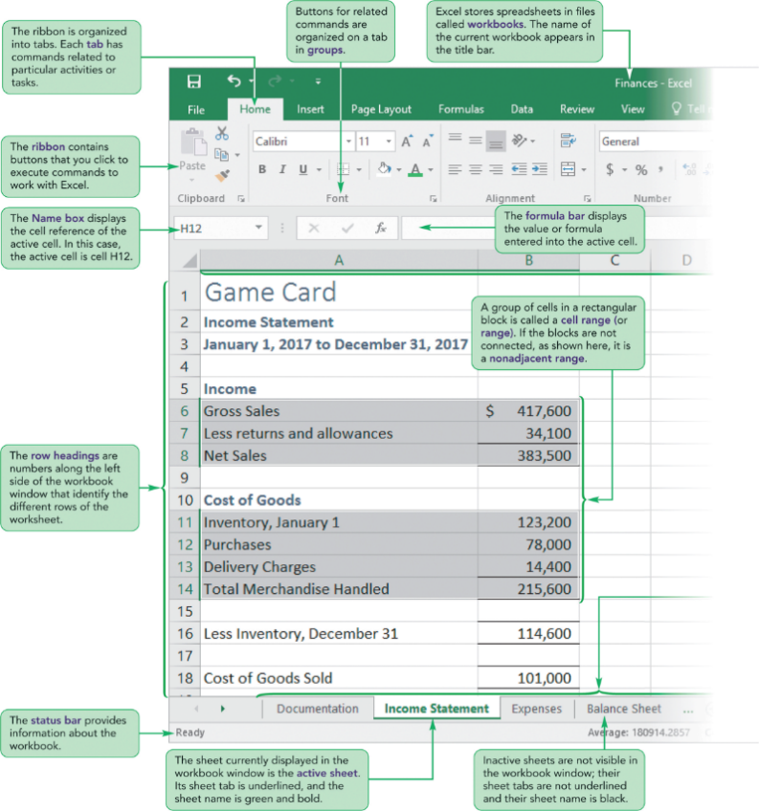
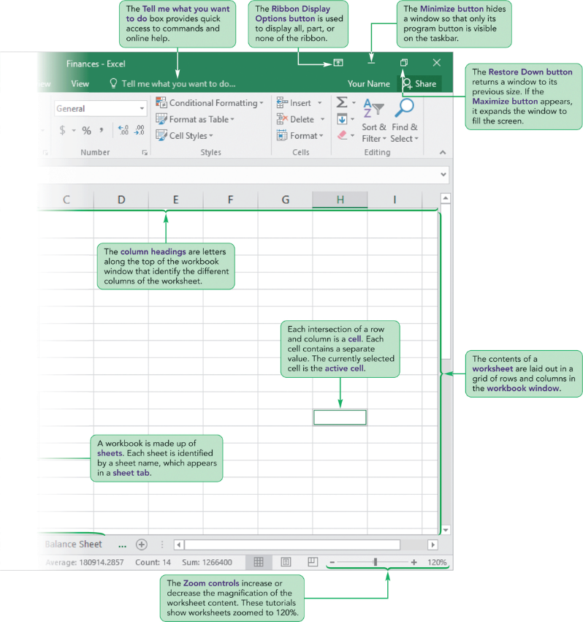

Slide 3
Function List
=SUM
=COUNT
=COUNTA
=AVERAGE

Slide 4
Student Learning Outcomes
Use for Demonstration: Excel1/Module/Finances.xlsx
Rename, inserting and move worksheets
Viewing Formulas and Functions (CTRL ~)
Cell Data
  Text, Numbers (numbers as text, different date formats)
  Formulas and Functions
Editing Cell Data
  Formula Bar, in the cell, Edit Mode (F2)

Slide 5
Student Learning Outcomes
Using FORMULAS and FUNCTIONS to Calculate Sales Data
Components of a FORMULA
ORDER OF OPERATIONS
Components of a FUNCTION

Slide 6
Student Learning Outcomes
Printing Options
  Portrait or Landscape (File Tab or Page Layout Tab)
  Scale to Fit (File Tab or Page Layout Tab)

Slide 7
Components of a FORMULA
Always starts with a =
OPERANDS (Cells, Numbers, “Text”)
OPERATORS ( ^ * / + - )
EXAMPLES:
=C6 / C23 | =B12
= C6 – (C7 + C8) | = C9 + C12 + C17 + C20 + C22
= C6 – D6

Slide 8
ORDER OF OPERATIONS
P
E
M
D
A
S

Slide 9
Components of a FUNCTION
Always starts with a =
Function Name
Arguments (Cell, Range, Number, “Text”)
EXAMPLE:
= SUM(C27:N46) | *If cells are adjacent, write the argument as a range.
= SUM(G9, G13, G18) | *If cells are not adjacent, separate them by commas.
= SUM(A9, B13:B18, G10) | *Arguments can contain cells, ranges, or numbers, separated by commas.

Slide 10
Do NOT Combine a Formula & Function
FORMULA | FUNCTION
= G9 + G13 + G18 | = SUM(G9, G13, G18) *If cells are not adjacent, separate them by commas.
WRONG: = SUM(G9 + G13 + G18)

Slide 11
Function List
=SUM
=COUNT
=COUNTA
=AVERAGE

