Slide 1
CS211 JavaScript Programming
Fall 2018
Instructor: Yvonne Flores

Slide 2
Lesson Objectives
New FALL2018 Requirements
Why Learn JavaScript?
Top Programming Languages 2018
Reply to Email that Syllabus received on Day 1.
READ the Syllabus.
  Course Assessment
  Course Outline
Notepad++ Installation
Online Resource: www.w3schools.com
Exercise: HTML Basics

Slide 3
Starting Fall 2018
Changes to the Associate in Computer Science Program
OLD Course | NEW Course
CS102 Computer Operations | CS212 Python Programming
CS103 RPG | CS213 PHP Programming
CS110 Introduction to Internet | CS211 JavaScript Programming
CS252 Advanced RPG | CS299 Computer Science Capstone

Slide 4
Why Learn JavaScript?
Search the Internet and read any number of web pages that answers the question

Slide 5
Why Learn JavaScript
JavaScript is one of the 3 languages all WEB DEVELOPERS must learn:
HTML is to tell the browser what content is being displayed.
  HTML – HyperText Markup Language
CSS is used to add color and style to the web page.
  CSS – Cascading Style Sheet
JavaScript to program the behavior of web pages to make it dynamic and interactive.

Slide 6
Why Learn JavaScript?
From (http://www.bestprogramminglanguagefor.me/why-learn-javascript)
Not to be confused with Java, JavaScript allows you to build interactive websites.
JavaScript has become an essential web technology along with HTML and CSS.
You must learn JavaScript if you want to get into:
  Web Development,
  if you're planning on being a Front-End developer
  or on using JavaScript for Back-End development.

Slide 7
Front-End vs. Back-End vs. Full-Stack
From https://blog.udacity.com/2014/12/front-end-vs-back-end-vs-full-stack-web-developers.html
Front-End Developer
  The front end of a website is the part that users interact with.
  Everything that you see when you’re navigating around the Internet, from fonts and colors to dropdown menus and sliders.
  The web site is a combo of HTML, CSS, and JavaScript being controlled by your computer’s browser.

Slide 8
Front-End vs. Back-End vs. Full-Stack
Back-End Developer
  So what makes the front end of a website possible?
  Where is all that data stored?
  The back end of a website consists of a server, an application, and a database.
  A back-end developer builds and maintains the technology that powers those components which, together, enable the user-facing side of the website to even exist in the first place.

Slide 9
Front-End vs. Back-End vs. Full-Stack
Full-Stack Developer
  Can work cross-functionally on the full “stack” of technology
  Both the Front-End and Back-End.

Slide 10
2018 Top Programming Languages
See the List from Stack Overflow Developers Survey Results(2018)
See the List from IEEE Spectrum (July 2018)
See the List from Business Insider (April 2018)

Slide 11
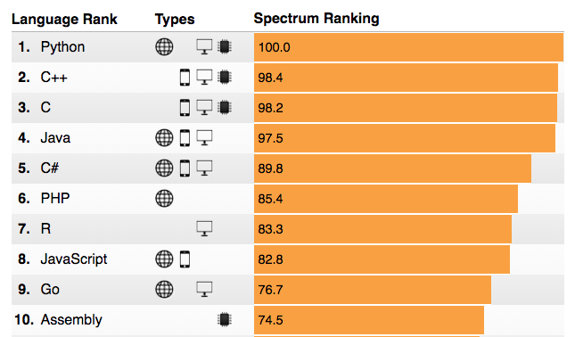
2018 Top Programming Languages (List from IEEE Spectrum (July 2018))
Source: https://spectrum.ieee.org/at-work/innovation/the-2018-top-programming-languages

Slide 12
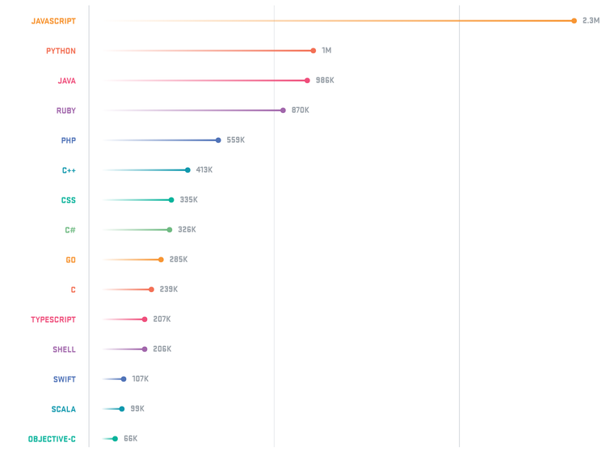
15 Most Popular Language on GitHub (July 2018)
Source: (https://octoverse.github.com/)

Slide 13
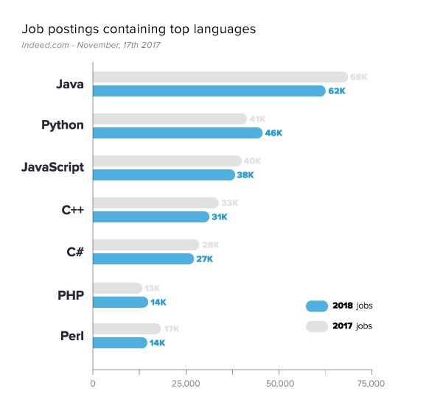
Job Postings for Top Programming Languages (List from (Nov 2017))
Source: (www.indeed.com)

Slide 14
Examples of what JavaScript can do
JavaScript can change HTML Content.
JavaScript can change HTML Attribute Values.
JavaScript can change HTML Styles (CSS).

Slide 15
GCC Web Page Source (www.guamcc.edu)
View HTML Code
  <html>, </html>
View CSS Code
  <style>, </style>, style
View JavaScript
  <script>, </script>

Slide 16
30 Interactive Websites
TOP Javascript Websites
Source: http://webdesignerwall.com/trends/30-truly-interactive-websites-built-css-javascript

Slide 17
BEST ADVICE
Use the many Internet resources to view examples of how to write code in JavaScript.

