Slide 1
External CSS

Slide 2
Lesson Objectives
CSS How to (External CSS)

Slide 3
W3Schools - Click on CSS How To
REVIEW: 3 Ways to Insert CSS in your HTML document
INLINE style – you have already done this in your previous exercises.
INTERNAL style sheet – in the <head> section of your HTML document between <style> and </style> tags.
EXTERNAL style sheet

Slide 4
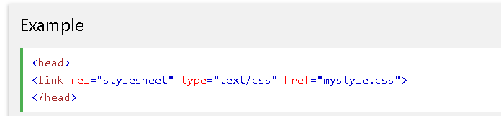
Method 3: Reference to the External Style Sheet
<link> tag within <head> and </head>

Slide 5
Method 3: External Style Sheet
Each page must include a reference to the external style sheet file inside the <link> element.
  The <link> element goes inside the <head> section.
  rel – used to define the relationship.
  text/css – indicates that the style sheet is written in CSS.
  href = “mystyle.css” – filename of the style sheet.

Slide 6
Here is how the “file.html" references the external .css file:
<!DOCTYPE html>
<html>
<head>
<link rel =“stylesheet” type=“text/css” href=“mystyle.css”>
</head>
<body>
content of the web page
</body>
</html
Looks for the .css stylesheet for all the styling of the .html file

Slide 7
Here is how the "mystyle.css" file looks:
Open NOTEPAD:
Enter the css code.
No <style> tag.
NO HTML <tags> in .css file
Save with: .css file extension
Save As Type: All files
In same location as .html file
body {background-color: linen;}
h1 {
color: maroon;
margin-left: 40px;
}

Slide 8
Method 3: External Style Sheet
With an external style sheet, you can change the look of an entire website by changing just one file.
An external style sheet can be written in any text editor, like Notepad.
The file should **NOT** contain any html <tags>.
The style sheet file must be saved with a .css extension.
  In Notepad – Choose Save As Type: All files

