Slide 1
Accreditation
Meet the President
October 18, 2023 – 4:00 PM

Slide 2
What is Accreditation and why is it important?
Accreditation is a practice of academic quality control.
Promotes institutional excellence through application of standards.
Advances meaningful and effective student learning and achievement.
Provides assurance to students, general public, & others of quality of educational offerings.
Accreditation is a peer review driven process.
Notes:
Vicky

Slide 3
Why Do Colleges Seek Accreditation?
Access to Title IV (Federal Financial Aid)
Recognition for transfer
Assure quality to the public and students
Ensure institutions are aligned with their missions
Improve academic quality, effectiveness, and student success
Notes:
Cheryl

Slide 4
Institutional accreditor recognized by U.S. Dept. of Education
Works collegially with member colleges to advance educational quality
Who is ACCJC?

Slide 5
Timeline
College
Self-Reflection
ISER
Team ISER Review
Standards Validation
Core Inquires
Off-Campus Site
Focused Site Visit
Core Inquires
On-Campus Site
Team Report
Commission Action
(Affirmation)
ISER
Due
8/1/24
Fall
2024
Spring
2025
June
2025
Notes:
-The peer review process is spread out over two semesters.
-Formative Assessment- this type of assessment typically concerns development and ongoing improvement
-Summative Assessment-this type of assessment typically concerns accountability, performance, and impact.
-The overall comprehensive review focuses on continuous quality improvement.
College Self-Reflection Institutional Self-Evaluation Report (ISER):
The process of the comprehensive review begins with self-evaluation and self-reflection of the institutional context and work in relation to the accreditation standards.
Key concepts woven through the 2024 ACCJC Standards:
-Equity
-Outcomes
-Innovations
-Improvements
Self-reflection is an ongoing commitment to improvement and educational excellence.
The ISER is developed through a collaborative partnership-multiple groups and perspectives working together. Later this month, a call out will be posted for faculty membership in the standards committees. Administrators and staff have already been appointed to serve in the committees.
As we develop the ISER, we need to:
-Celebrate and appreciate what works well
-Look for alignment with standards
-Focus on outcomes
-Conduct evidence based analysis
-Be open-minded to improve
-Be internally accountable
-Think holistically across institutional systems
-Be mindful of mission accomplishment and values
During the self-reflection we identify successes, gaps, and areas for improvement.
The College documents its work in the Institutional Self-Evaluation Report (ISER) in relation to the standards and then the College submits the ISER to ACCJC.
Team ISER Review: Standards Validation, Core Inquiries, Off-Campus Site:
Based on the College’s ISER and evidence, the team discusses potential areas of exceptional practice, potential areas of concern, and areas in need of clarification.
During this time, the team is developing the core inquiries. Core inquiries provide formative feedback to the College. It’s the heads up to the College on what the site visit will focus on.
When the College receives the core inquiries, the College has time to prepare for the next part of the peer review process which will occur in the subsequent semester.
The College is using the time leading up to the focused site visit to to reflect on the core inquiries, gather needed evidence, strengthen and develop processes, and prepare its responses to the core inquiries.
Focused Site Visit:
A subset of the full ISER review team comes to the College and they follow-up on the core inquiries.
This is also when the team wraps up their team report and concludes the peer review team work in identifying recommendations and commendations.

Slide 6
STANDARD 1 Institutional Mission & Effectiveness
GCC has a clearly defined mission that reflects its character, values, organizational structure, and unique student population.
GCC’s mission outlines its explicit commitment to equitable student achievement and serves as a guiding principle for institutional planning, action, evaluation, improvement, and innovation.

Slide 7
In alignment with its mission, GCC delivers high-quality academic and learning support programs that engage and support students through their unique educational journeys.
Academic and learning support programs promote equitable student success, and GCC evaluates student learning and achievement data to inform improvements and advance equitable outcomes.
STANDARD 2 Student Success

Slide 8
STANDARD 3 Infrastructure & Resources
GCC supports its educational services and operational functions with effective infrastructure, qualified personnel, and stable finances.
GCC organizes its staffing and allocates its physical, technological, and financial resources to improve its overall effectiveness and promote equitable student success.
GCC actively monitors and assesses resource capacity to inform improvements to infrastructure and ensure long-term health and stability

Slide 9
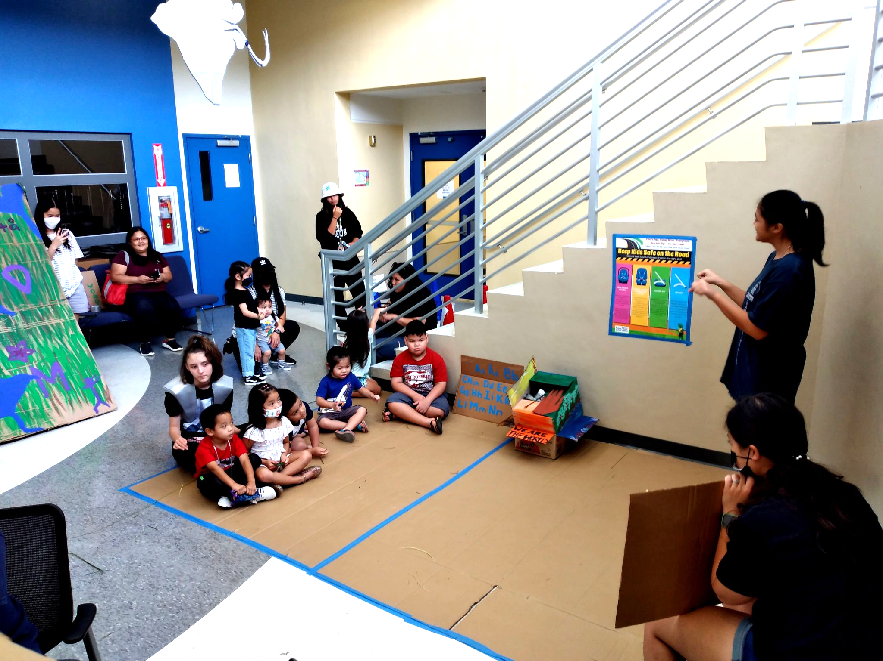
STANDARD 4 Leadership & Governance
GCC engages in clear and effective governance practices that support the achievement of its mission.
Governance roles and responsibilities are delineated in widely distributed policies, and institutional decision-making processes provide opportunities for meaningful participation and inclusion of relevant stakeholders.

Slide 10
Questions to consider as we develop our ISER
FOCUS:
What is GCC doing to align with the standard?
Why is GCC doing what it is doing?
How does GCC support equity and innovation?
What lessons have we learned from this journey?
What does GCC plan to do differently to promote innovation?
-OUTCOMES
-INNOVATION
-IMPROVEMENT

Slide 11
As part of the ongoing effort to develop our Institutional Self Evaluation Report (ISER) for accreditation, we invite everyone to participate in the scheduled Standard Committee meetings this semester.
Standard 1 – Every Thursday from 2:00pm – 3:30pm
President’s Conference Room (PCR).
Chair – Dr. Michael Chan
Co-Chair – Dr. Anthony Jay Sunga
Standard 2 – Every Friday from 2:00pm – 3:00pm
President’s Conference Room (PCR).
Chair – Marivic Schrage
Co-Chair – Dr. Marsha Postrozny-Torres
Standard 3 – Every Tuesday from 2:00pm – 3:30pm
Student Support Services & Administration Conference Room (SSA)
Chair – Apolline San Nicolas
Co-Chair – Rodalyn Gerardo
Co-Chair – Carl Torres II
Standard 4 – Every Friday from 10:00am – 12:00pm
President’s Conference Room (PCR).
Chair – Carol Cruz
Co-Chair – Dr. Julie Ulloa-Heath
Your input is valuable. We look forward to hearing from you.

