Slide 1
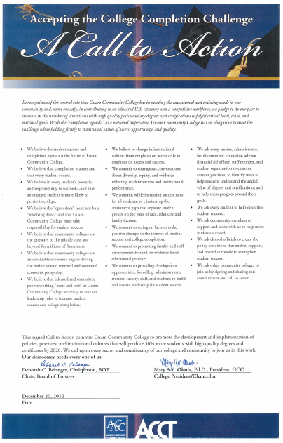
WELCOME
to the
Fall 2013
College Assembly

Slide 2
The mission of
Guam Community College
is to be a leader in career and
technical workforce development
by providing the highest quality
education and job training
in Micronesia.

Slide 3
Completion matters.
Every student counts.
We believe in every student’s potential and responsibility to succeed, and that an engaged student is more likely to persist in college.
SOURCE: Accepting the College Completion Challenge-A Call to Action
Signed 12/20/12 by BOT Chairperson and President

Slide 5
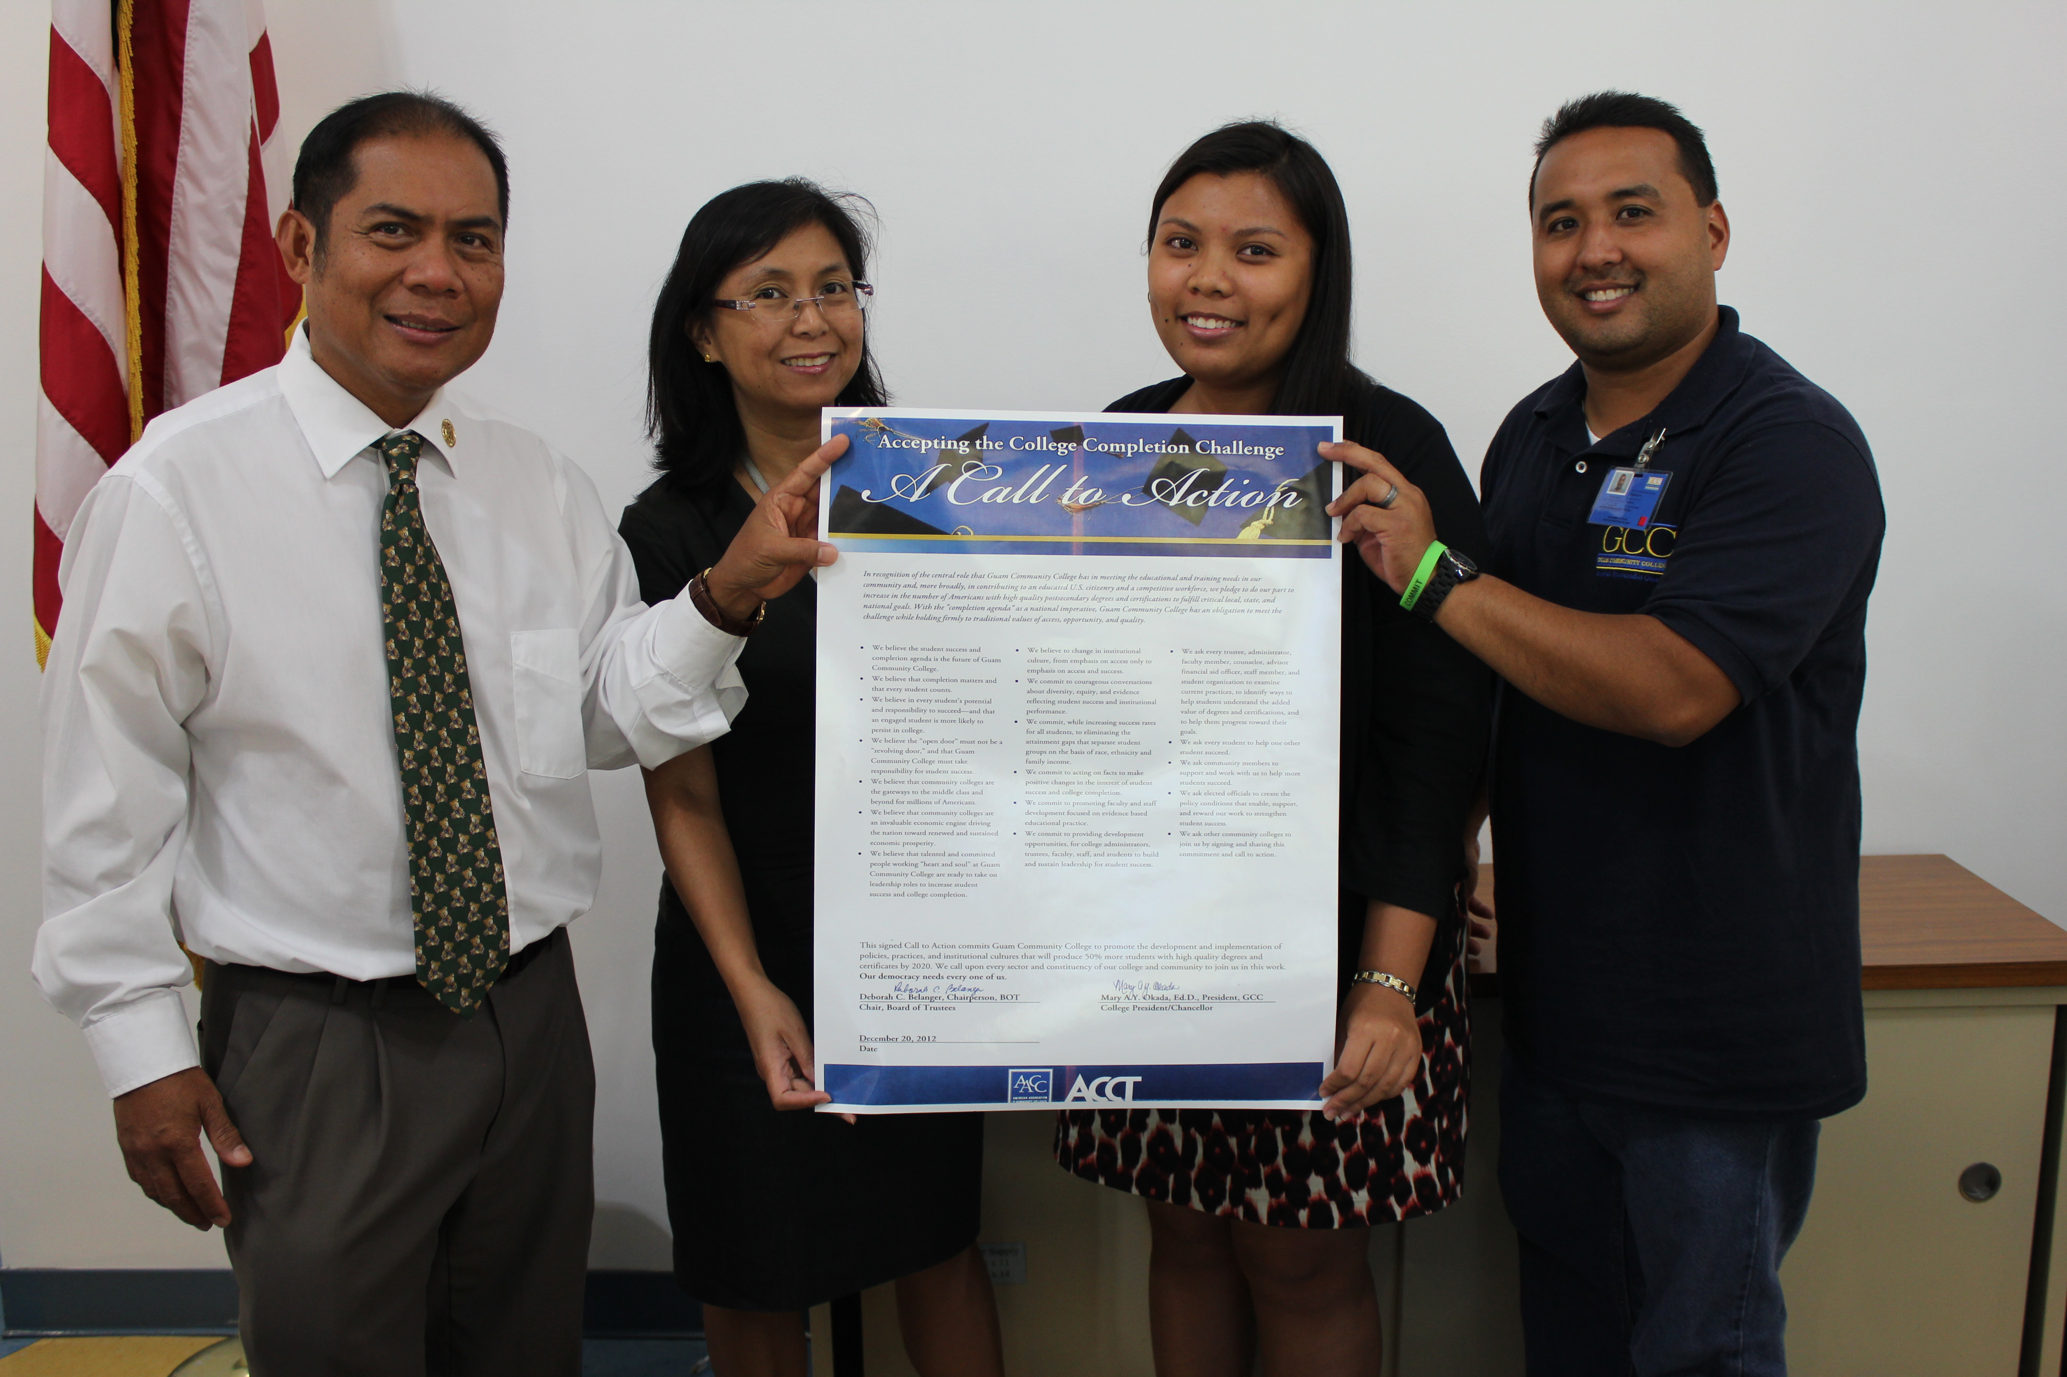
Phi Theta Kappa
Completion Initiative

Slide 6
Student Success and Completion
as an
Institutional Conversation

Slide 7
The Big Picture
Student Success & Completion

Slide 8
2014
Budget Law
Requirements

Slide 9
Quarterly reports
Participants in each GCC program
Description of each program
Academic courses offered
Requirements for participation in
each program
Source: P.L. No. 32-068, Bill No. 1 (4-S), Chapter II, Part III, Section 3

Slide 10
The President of the University of Guam, the President of the Guam Community College, and the Director of the Guam Department of Labor shall transmit a report to I Maga’låhen Guåhan and to the Speaker of I Liheslaturan Guåhan, no later than June 30 of each year, of the actual number of program completers and/or certificates issued for each program, and employment data for said program completer for the two (2) years following completion of their respective programs, to include salary levels, job location, or whether the job is in the same field as the program.
Source: P.L. No. 32-068, Bill No. 1 (4-S), Chapter XII, Section 15, Subsection (a)

Slide 11
The report mandated in Subsection (a) shall also be posted on each agency’s respective website.
Source: P.L. No. 32-068, Bill No. 1 (4-S), Chapter XII, Section 15, Subsection (b)

Slide 12
College Readiness & Adult Education: Ensuring Student Success and Completion

Slide 13
Accreditation
Updates

Slide 14
Standard 1: Mission, Academic Quality, Institutional Effectiveness and Integrity (26)
A. (1)
B. (2)
C. (3)
Standard 2: Student Learning Programs and Support Services (34)
A. (8)
B. (3)
Standard 3: Resources (40)
A. (4)
B. (0)
C. (2)
D. (2)
Standard 4: Leadership and Governance (33)
A. (2)
B. (1)
C. (3)
D. (2)
TOTAL = 133

Slide 15
The institution uses documented assessment of student learning and achievement to communicate matters of academic quality to appropriate constituencies, including current and prospective students and the public. (1.C.3)
SOURCE: Accrediting Commission for Community and Junior Colleges,
Western Association of Schools and Colleges, Working Draft: Proposed Revisions To Standards, Fall 2013.

Slide 16
The institution schedules courses in a manner that allows students to complete certificate and degree programs within a period of time consistent with established expectations for completion at two-year institutions. (2.A.10)
SOURCE: Accrediting Commission for Community and Junior Colleges,
Western Association of Schools and Colleges, Working Draft: Proposed Revisions To Standards, Fall 2013.

Slide 17
The institution defines and advises students on clear pathways to complete degrees, certificates and transfer goals. (2.B.6)
SOURCE: Accrediting Commission for Community and Junior Colleges,
Western Association of Schools and Colleges, Working Draft: Proposed Revisions To Standards, Fall 2013.

Slide 18
Guam Community College Institutional Strategic Master Plan (ISMP) 2014-2020

Slide 19
VISION
Guam Community College will be the premier educational institution for providing globally recognized educational and workforce development programs.

Slide 20
Mission
Guam Community College is a leader in career and technical workforce development by providing the highest quality student-centered education and job training for Micronesia.

Slide 21
Core Values
Diversity
Accountability
Service
Integrity
Learning-Centered
Student-Focused

Slide 22
GOALS

Slide 23
Goal 1: Strengthen and improve curriculum and educational delivery to provide a student-centered educational experience that fosters retention and completion to prepare our students for engagement in a global workforce.

Slide 24
Goal 2: Transform the campus into a conducive facility for learning and teaching with a genuine sense of family spirit and dialogue among employees who are committed to student access and student success.

Slide 25
Goal 3: Enhance the existing integrated planning, review, and evaluation process that provides for the allocation of resources based on assessment results and college-wide priorities that boost improvement and accountability.

Slide 26
Goal 4: Promote the Guam Community College brand to reach regional, national, and international recognition.

Slide 27
Goal 4: Promote the Guam Community College brand to reach regional, national, and international recognition.

Slide 28
Strategic Initiatives

Slide 29
Goal 1
Incorporate the student-centered learning model into the curriculum and the classroom.
Strengthen the professional development support for faculty to effectively implement the student-centered teaching method.

Slide 30
Goal 2
Enhance, and monitor the College’s facilities master plan to keep pace with institutional growth and educational projections and priorities.
Strengthen the participatory governance process to ensure that all stakeholders understand their role in collaborative governance.

Slide 31
Goal 3
Update the College’s existing institutional financial/resource allocation master plan to align with the College’s new ISMP’s vision, mission, and goals.
Utilize the institution’s assessment system and program review to evaluate the effectiveness of the College’s resource allocation process.

Slide 32
Goal 4
Promote and highlight the GCC brand.
Internationalizing our campus

Slide 33
Internationalizing Our Campus
Learn, support, and build on the existing languages, cultures, and histories of Guam’s diverse peoples;
Develop, inspire, and instill respect and honor for various cultures among our students, faculty and other constituents;
Construct viable and robust educational and economic regional and international partnerships; and,
Fortify the college’s role as a gateway to and bridge between Asia, the Pacific, the Americas, and the world.

Slide 34
We commit, while increasing success rates for all students, to eliminating the attainment gaps that separate student groups on the basis of race, ethnicity and family income.
We commit to acting on facts to make positive changes in the interest of student success and college completion.
SOURCE: Accepting the College Completion Challenge-A Call to Action
Signed 12/20/12 by BOT Chairperson and President

Slide 35
Completion Agenda
Guam Community College
2013

Slide 36
As part of his effort to build a stronger foundation that will allow the U.S. to lead in the global economy, President Obama announced the American Graduation Initiative, which calls for 5 million additional community college graduates by 2020.

Slide 37
Unique Enrolled/Unique Completed

Slide 38
Program Completion Rate
YEAR | UNIQUE ENROLLED | UNIQUE COMPLETED | %
2006 | 1084 | 136 | 12.5
2007 | 1089 | 66 | 6.1
2008 | 887 | 95 | 10.7
2009 | 1274 | 160 | 12.6
2010 | 1312 | 168 | 12.8
2011 | 1260 | 205 | 16.3
2012 | 1206 | 172 | 14.3
TOTAL | 8112 | 1002 | 12.4

Slide 39
English Placement Test Results: AY2006 to AY2013
Notes:
There are many variables that may have an impact on program completion, including college readiness, personal commitments, work commitments, and transportation issues.
As a college, we cannot control all the variables that impact program completion, but we can address college readiness.
There is a connection between college readiness and placement into developmental courses. Students placed into developmental courses need additional instruction to be able to progress in their programs.
A number of students entering GCC need to take developmental courses, and not all students placed into a given developmental course, start the course at the same level. For example, some students enrolled into EN100R have greater skill sets than others who are also placed into the same course. Consequently, our faculty have to work with the varying degrees of skill levels in each of these courses.
Since AY05-06, most students who took the English placement test placed into EN100W (6,517) followed by EN100RW (1,788), EN110 (1,502), EN100B (501) and EN100R (448). In AY12-13, placement in EN100W (336) and EN110 (337) were nearly the same.

Slide 40
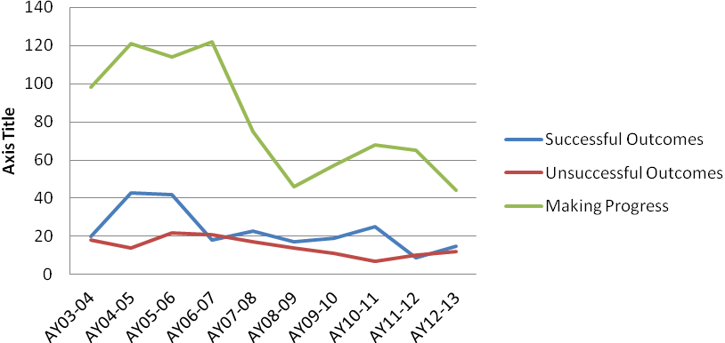
EN100B Completion Rates (AY03-04 to AY12-13)
Notes:
As seen in this line graph, for the past two academic years, there has been an improvement in successful completions in EN100B.

Slide 41
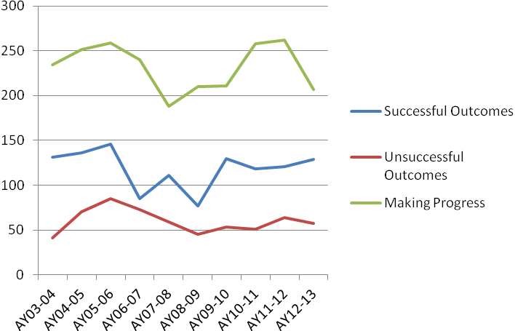
EN100R Completion Rates (AY03-04 to AY12-13)
Notes:
This second line graph shows an improvement in the number of successful completions in EN100R for the past three academic years.

Slide 42
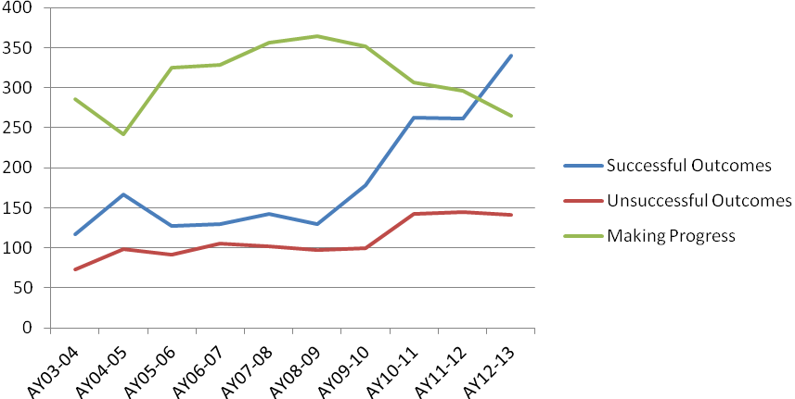
EN100W Completion Rates (AY03-04 to AY12-13)
Notes:
And this third line graph shows an improvement in the successful completions in EN100W for the past three academic years. Since AY08-09, there has been a general improvement in EN100W completion rates.

Slide 43
Figure 13. Math Placement Test Results: AY2006 to AY2013
Notes:
Since AY05-06, most students who took the math placement test placed into MA085 (3132), followed by MA095 (3014). However, in the past three academic years, placement was greater in MA095. This suggests that the college readiness of our students, in the area of math, may be improving.

Slide 44
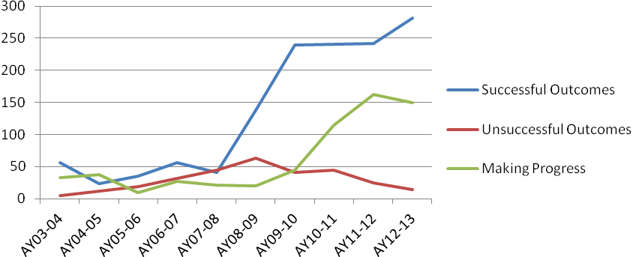
MA085 Completion Rates (AY03-04 to AY12-13)
Notes:
This line graph shows that the successful completions of students in MA085 have increased continuously for the past five academic years.

Slide 45
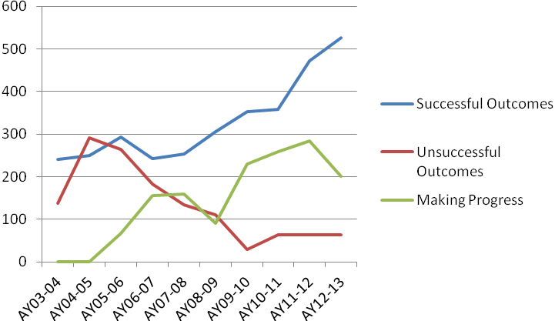
MA095 Completion Rates (AY03-04 to AY12-13)
Notes:
And, this second line graph shows that successful outcomes in MA095 has increased continuously for the past six years.
The goal is to continue to decrease the number of unsuccessful outcomes and increase the successful outcomes.
Currently, AIER is looking at how many of our students who enrolled into developmental courses actually complete a degree or program.
Dialogue regarding student progress in developmental courses have been held with the English and math/science faculty. During these conversations we have stressed that program completion is not the responsibility of one or two departments, but the responsibility of the institution as a whole because once students complete developmental courses, they move on to the other courses required for their programs.
As an institution, we all need to look at how we can help our students complete their programs.
During discussions with the English and math/science faculty, we discussed best practices in education related to developmental education.

Slide 46
-Support programs -Early intervention programs -Compressed-format classes vs. regular-length courses -Revisit student placement into developmental courses -Require advising for all developmental students until they have completed all the required developmental courses
Best Practices
Notes:
Some of the best practices that were discussed include—
Support programs (i.e. tutoring)
Early intervention programs (identifying students who are really struggling and provide them with assistance early on)
Compressed format classes– offer developmental courses in an eight week format versus a 15 week format to get students to complete their
development courses quicker
Revisit student placement into developmental courses (perhaps place students who are near the cut-off mark between levels to be placed at the higher level)
Require advising for all developmental students until they have completed all the required developmental courses. Discussions with the Registrar have occurred regarding assigning students placed into developmental courses to faculty who teach those courses.
Short, intensive review/refresher course (to help students prepare for the placement test) Maybe through CE, during intercessions, or on weekends. -Professional development for faculty (instructional strategies, developmental education) -“one-stop learning center” for advising and tutoring (Student Success Center)
These are just a few of the best practices in developmental education. I commend our English and math/science faculty for taking a proactive approach and reviewing these best practices, as well as others, to see how we can help our students succeed.
We encourage similar discussions within CTE departments as well. Discussions between faculty who teach general education courses and those who teach CTE courses must also occur. What is taught in general education courses reinforces the learning experience in CTE courses.
One of the areas of preparation for college is in adult Education. Dr. Flores will now provide you with information on some proposed changes to adult education.

Slide 47
Best Practices
-Short, intensive review/refresher course
-Professional development for faculty (instructional strategies, developmental education)
-“one-stop learning center” for advising and tutoring
Notes:
These are just a few of the best practices in developmental education. I commend our English and math/science faculty for taking a proactive approach and reviewing these best practices, as well as others, to see how we can help our students succeed.
We encourage similar discussions within CTE departments as well. Discussions between faculty who teach general education courses and those who teach CTE courses must also occur. What is taught in general education courses reinforces the learning experience in CTE courses.
One of the areas of preparation for college is in adult Education. Dr. Flores will now provide you with information on some proposed changes to adult education.

Slide 48
ADULT EDUCATION
What we have now. . .
CASAS
ESL
Basic Education
Adult High School
HS Equivalency Test Prep

Slide 49
ADULT EDUCATION
Next Steps . . .
What?
Standards – Based
College and Career Readiness (Common Core)
Respond more to participants’ learning styles and needs

Slide 50
ADULT EDUCATION
Next Steps . . .
Why?
Alignment with College and Industry Expectations
High School Equivalency Test
Expectations of US Education Department Office of Vocational and Adult Education

Slide 51
ADULT EDUCATION
How?
Revamp Program and Course Guides
Focus on Standards-Based Proficiency
Professional Development for Instructors

Slide 52
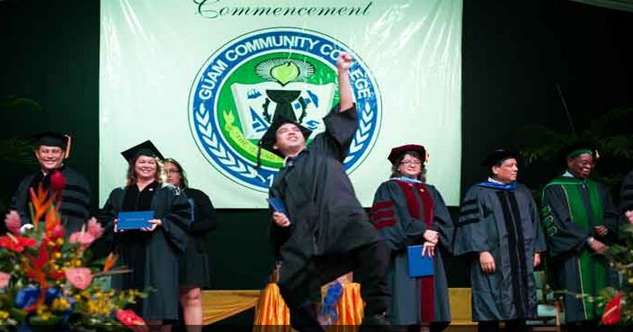
Guam Community College 2013

Slide 53
Completion Agenda
Guam Community College
2013

Slide 54
As part of his effort to build a stronger foundation that will allow the U.S. to lead in the global economy, President Obama announced the American Graduation Initiative, which calls for 5 million additional community college graduates by 2020.

Slide 55
Unique Enrolled/Unique Completed

Slide 56
Program Completion Rate
YEAR | UNIQUE ENROLLED | UNIQUE COMPLETED | %
2006 | 1084 | 136 | 12.5
2007 | 1089 | 66 | 6.1
2008 | 887 | 95 | 10.7
2009 | 1274 | 160 | 12.6
2010 | 1312 | 168 | 12.8
2011 | 1260 | 205 | 16.3
2012 | 1206 | 172 | 14.3
TOTAL | 8112 | 1002 | 12.4

Slide 57
English Placement Test Results: AY2006 to AY2013
Notes:
There are many variables that may have an impact on program completion, including college readiness, personal commitments, work commitments, and transportation issues.
As a college, we cannot control all the variables that impact program completion, but we can address college readiness.
There is a connection between college readiness and placement into developmental courses. Students placed into developmental courses need additional instruction to be able to progress in their programs.
A number of students entering GCC need to take developmental courses, and not all students placed into a given developmental course, start the course at the same level. For example, some students enrolled into EN100R have greater skill sets than others who are also placed into the same course. Consequently, our faculty have to work with the varying degrees of skill levels in each of these courses.
Since AY05-06, most students who took the English placement test placed into EN100W (6,517) followed by EN100RW (1,788), EN110 (1,502), EN100B (501) and EN100R (448). In AY12-13, placement in EN100W (336) and EN110 (337) were nearly the same.

Slide 58
EN100B Completion Rates (AY03-04 to AY12-13)
Notes:
As seen in this line graph, for the past two academic years, there has been an improvement in successful completions in EN100B.

Slide 59
EN100R Completion Rates (AY03-04 to AY12-13)
Notes:
This second line graph shows an improvement in the number of successful completions in EN100R for the past three academic years.

Slide 60
EN100W Completion Rates (AY03-04 to AY12-13)
Notes:
And this third line graph shows an improvement in the successful completions in EN100W for the past three academic years. Since AY08-09, there has been a general improvement in EN100W completion rates.

Slide 61
Figure 13. Math Placement Test Results: AY2006 to AY2013
Notes:
Since AY05-06, most students who took the math placement test placed into MA085 (3132), followed by MA095 (3014). However, in the past three academic years, placement was greater in MA095. This suggests that the college readiness of our students, in the area of math, may be improving.

Slide 62
MA085 Completion Rates (AY03-04 to AY12-13)
Notes:
This line graph shows that the successful completions of students in MA085 have increased continuously for the past five academic years.

Slide 63
MA095 Completion Rates (AY03-04 to AY12-13)
Notes:
And, this second line graph shows that successful outcomes in MA095 has increased continuously for the past six years.
The goal is to continue to decrease the number of unsuccessful outcomes and increase the successful outcomes.
Currently, AIER is looking at how many of our students who enrolled into developmental courses actually complete a degree or program.
Dialogue regarding student progress in developmental courses have been held with the English and math/science faculty. During these conversations we have stressed that program completion is not the responsibility of one or two departments, but the responsibility of the institution as a whole because once students complete developmental courses, they move on to the other courses required for their programs.
As an institution, we all need to look at how we can help our students complete their programs.
During discussions with the English and math/science faculty, we discussed best practices in education related to developmental education.

Slide 64
-Support programs -Early intervention programs -Compressed-format classes vs. regular-length courses -Revisit student placement into developmental courses -Require advising for all developmental students until they have completed all the required developmental courses
Best Practices
Notes:
Some of the best practices that were discussed include—
Support programs (i.e. tutoring)
Early intervention programs (identifying students who are really struggling and provide them with assistance early on)
Compressed format classes– offer developmental courses in an eight week format versus a 15 week format to get students to complete their
development courses quicker
Revisit student placement into developmental courses (perhaps place students who are near the cut-off mark between levels to be placed at the higher level)
Require advising for all developmental students until they have completed all the required developmental courses. Discussions with the Registrar have occurred regarding assigning students placed into developmental courses to faculty who teach those courses.
Short, intensive review/refresher course (to help students prepare for the placement test) Maybe through CE, during intercessions, or on weekends. -Professional development for faculty (instructional strategies, developmental education) -“one-stop learning center” for advising and tutoring (Student Success Center)
These are just a few of the best practices in developmental education. I commend our English and math/science faculty for taking a proactive approach and reviewing these best practices, as well as others, to see how we can help our students succeed.
We encourage similar discussions within CTE departments as well. Discussions between faculty who teach general education courses and those who teach CTE courses must also occur. What is taught in general education courses reinforces the learning experience in CTE courses.
One of the areas of preparation for college is in adult Education. Dr. Flores will now provide you with information on some proposed changes to adult education.

Slide 65
Best Practices
-Short, intensive review/refresher course
-Professional development for faculty (instructional strategies, developmental education)
-“one-stop learning center” for advising and tutoring
Notes:
These are just a few of the best practices in developmental education. I commend our English and math/science faculty for taking a proactive approach and reviewing these best practices, as well as others, to see how we can help our students succeed.
We encourage similar discussions within CTE departments as well. Discussions between faculty who teach general education courses and those who teach CTE courses must also occur. What is taught in general education courses reinforces the learning experience in CTE courses.
One of the areas of preparation for college is in adult Education. Dr. Flores will now provide you with information on some proposed changes to adult education.

Slide 66
ADULT EDUCATION
What we have now. . .
CASAS
ESL
Basic Education
Adult High School
HS Equivalency Test Prep

Slide 67
ADULT EDUCATION
Next Steps . . .
What?
Standards – Based
College and Career Readiness (Common Core)
Respond more to participants’ learning styles and needs

Slide 68
ADULT EDUCATION
Next Steps . . .
Why?
Alignment with College and Industry Expectations
High School Equivalency Test
Expectations of US Education Department Office of Vocational and Adult Education

Slide 69
ADULT EDUCATION
How?
Revamp Program and Course Guides
Focus on Standards-Based Proficiency
Professional Development for Instructors

Slide 70
Guam Community College 2013

