Slide 1
School Name
Cognos Administration Training
Your Name

Slide 2
Agenda
Cognos 8 Architecture Overview
Role Responsibilities
Cognos Connection
Cognos Connectivity Overview
Cognos Security and Permissions
  Cognos Configuration
  Cognos Administration
  Cognos Connection
  Cumulative Security

Slide 3
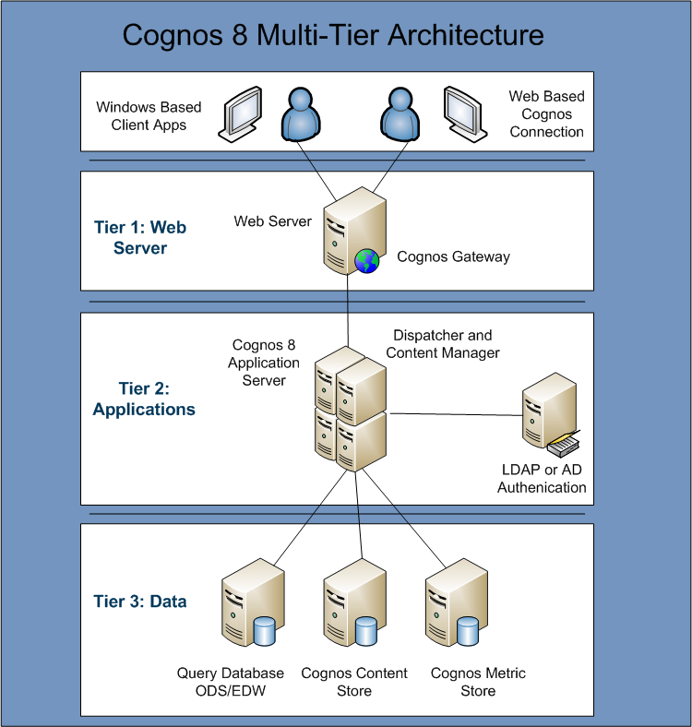
Notes:
Cognos uses JDBC driver to communicate to the content and metric store databases while API for Query Databases.

Slide 4
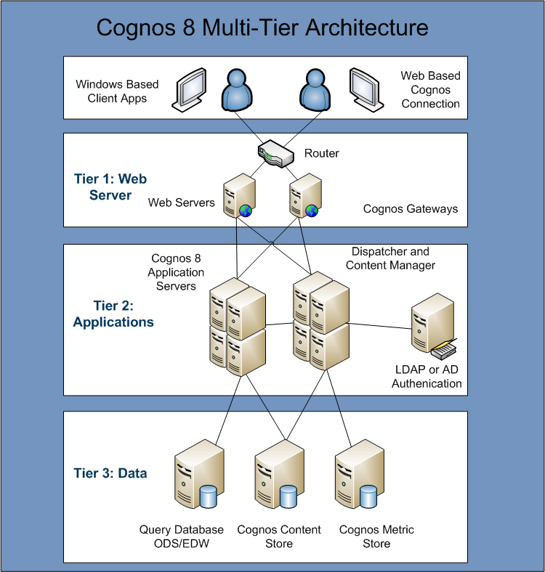
Notes:
Cognos uses JDBC driver to communicate to the content and metric store databases while API for Query Databases.

Slide 5
Role Responsibilities
Cognos Administrator
  Typically responsible for:
    Authentication into Cognos
    Services – Gateway, Dispatchers, and Content Managers
    Manage Cubes
Data Modeler
  Typically responsible for:
    Managing metadata layer Projects (Models)
    Creation and Publishing Packages
Report Author
  Typically responsible for:
    Creating reports based on Packages published by the Data Modeler
Consumer
  Users that view or run reports in Cognos Connection
Notes:
Project – File that holds all of the Metadata objects, Parameter Maps, Packages, Data Sources
Namespace – Container for holding objects that provides a unique name to prevent naming conflicts (Performance Management)
Model – Metadata Objects organized into layers (Database, Business, and Presentation) – everything inside the namespace “Performance Management” is the model
Data Source – Database, Cube, or file where the information is coming from
Parameter Map – List of Parameters used to create conditional query subjects that allow for substitutions at report run time
Package – Subset of the query subjects and other objects defined in the project; published for use as a model by report authors

Slide 6
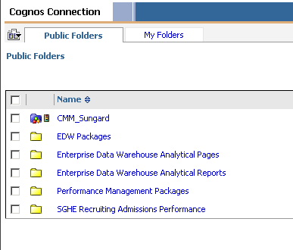
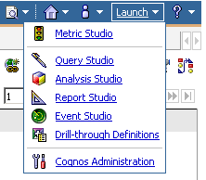
Cognos Connection
Web based portal with single access point
Entry point for Report Authors, Report Consumers, System Administrators, and Content Administrators
Folder structure holds reports, dashboards, performance charts, and scorecards
Content can be saved as either Public or Private
Notes:
Query Item - Columns

Slide 7
Cognos Components
Cognos
Framework
Manager
Client Based
Content
Store
Package
Operational
Data Store
Cognos Connection
ETL
Banner
Report Studio, Query Studio,
Analysis Studio, Metric Studio
Web Browser
Report Consumers
Notes:
7
Relationship module data passed to Operational Data Store
That same data is ETL’d to the Enterprise Data Warehouse

Slide 8
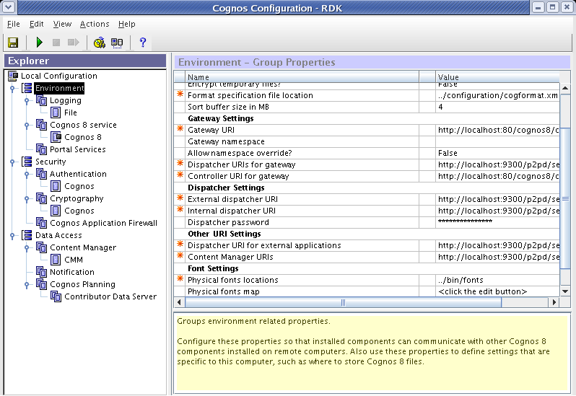
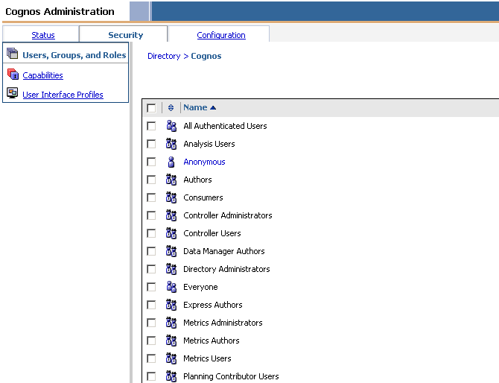
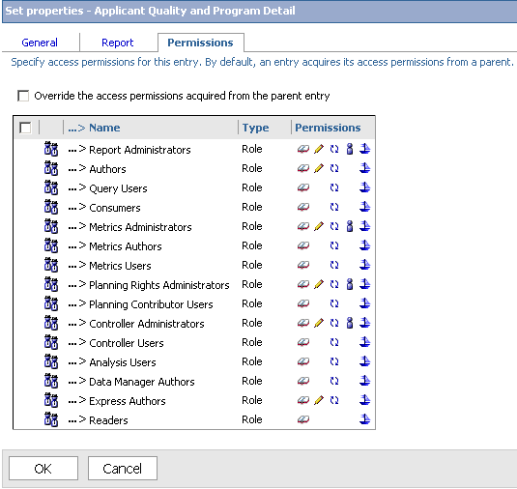
Cognos Security and Permissions
A combination of settings in Cognos Configuration, Cognos Administration and Cognos Connection are used to secure an environment
Cognos Configuration Anonymous access and Authentication connection
Cognos Administration
Authorization and Capabilities
Cognos Connection
Content Access

Slide 9
Cognos Configuration
Single point of server configuration for your environment
Handles connection information for Cognos Content database
Allows you to turn Cognos Services on or off, and start and stop the system
Used locally for Windows based client tools to connect to the Cognos environment

Slide 10
Cognos Administration
Manages authentication into Cognos and authorization of user access to features and functionality
Check the status of current, past, and upcoming activities
Configure the environment, it’s services, and import and export content

Slide 11
Cognos Connection
Set permissions to reporting object within Cognos Connection
Permissions are applied hierarchically with children acquiring permissions from the parent
Permissions such as Read, Write, Execute, Set Properties, and Traverse are applied to Groups or Roles
Permissions are cumulative

Slide 12
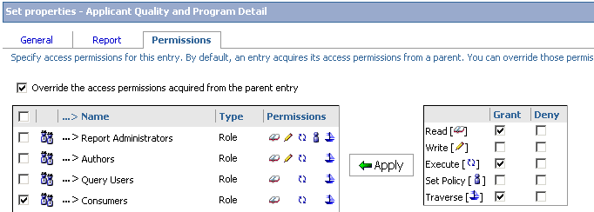
Cumulative Security
Joe – Group A Denied
Joe – Group A Denied
Denied
Admissions
Folder
Joe – Group B Granted
Joe – Group B Not Specified

Slide 13
Cumulative Security
Joe – Group A Not Specified
Joe – Group A Not Specified
Granted
Denied
Admissions
Folder
Joe – Group B Granted
Joe – Group B Not Specified

