Slide 1

“Science, Community, & the Future”
PPEC Annual Meeting
6 Aug 2014
Community & Natural Resources
American Samoa Community College
Tapa’au Dr. Dan Aga, AF
Notes:
Don’t read from Slides
Slides Supplement your talk
Not too much text

Slide 2
I. History
II. Regional Collaborations
III. Local Priorities
IV. Future
Notes:
Don’t read from Slides
Slides Supplement your talk
Not too much text

Slide 3
What we do
Research
Extension
Instruction
Agriculture
Natural Resources
Life Sciences
Notes:
Nothing new to all of you who are well-versed in the programs of your institutions
Job seems to have become to tell the story
US feeds the world

Slide 4
I. History
Democratic Ideals
“1972 didn’t just happen.”
Notes:
US feeds the World
Civil War Trust: ideals that expanded access to higher education: clergy –1862’s & 1890’s -- research institutions -- WWII – CC’s – Student Financial Aid – ECE – Special Ed
Take the University to the People

Slide 5
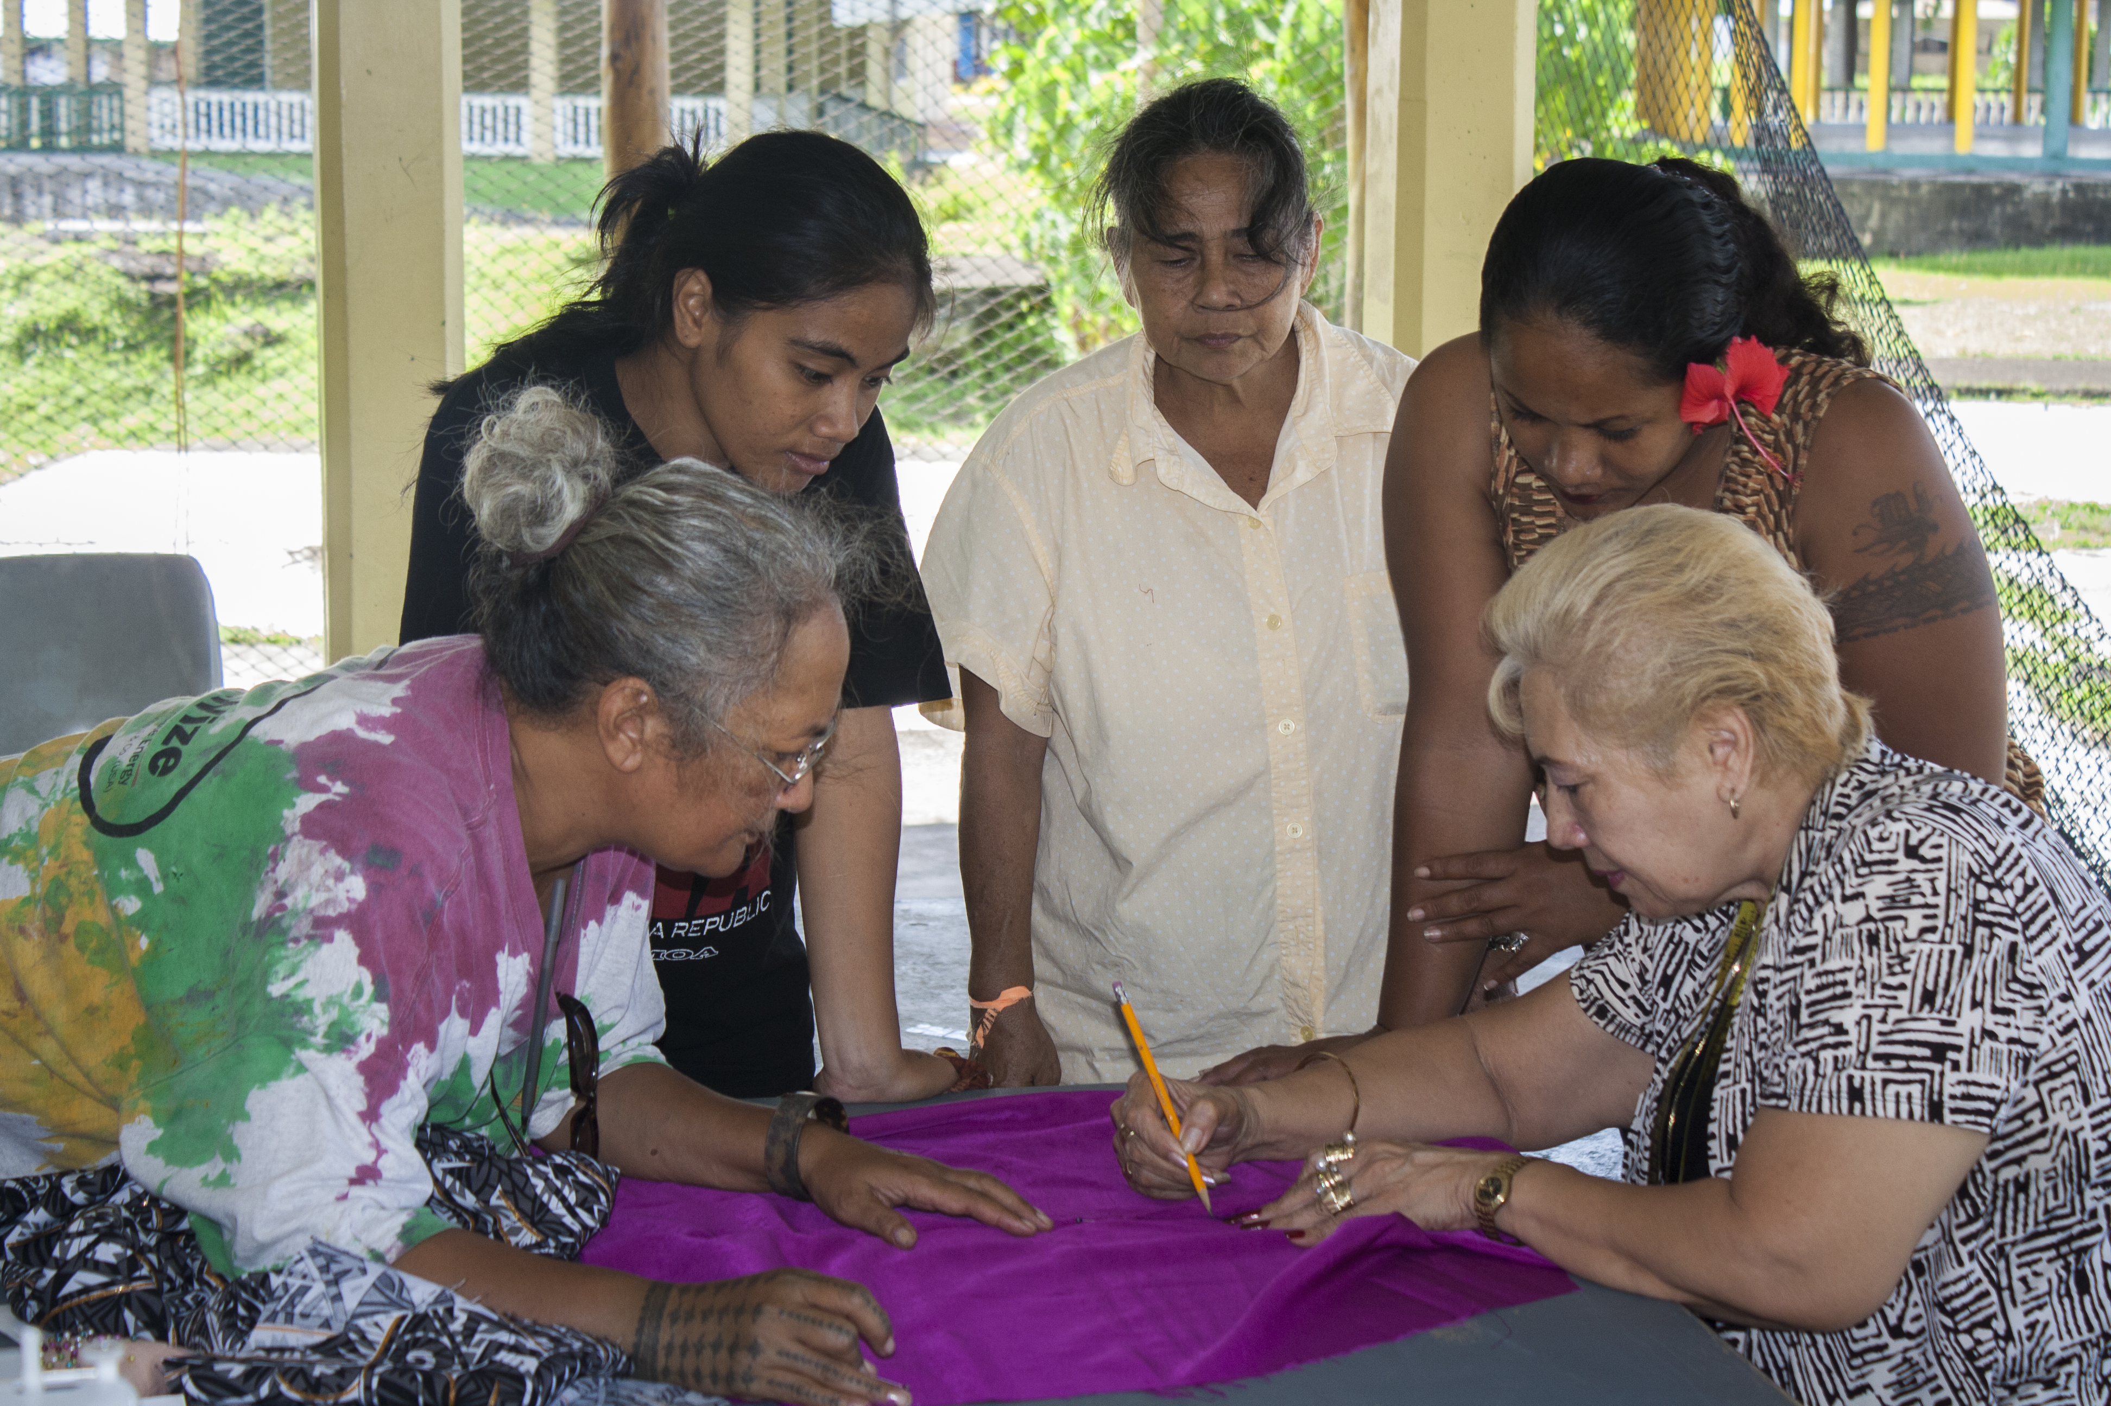
ADAP & PLGA
PIFC
CHL
CariPac
Notes:
Sewing Certificate not important

Slide 6
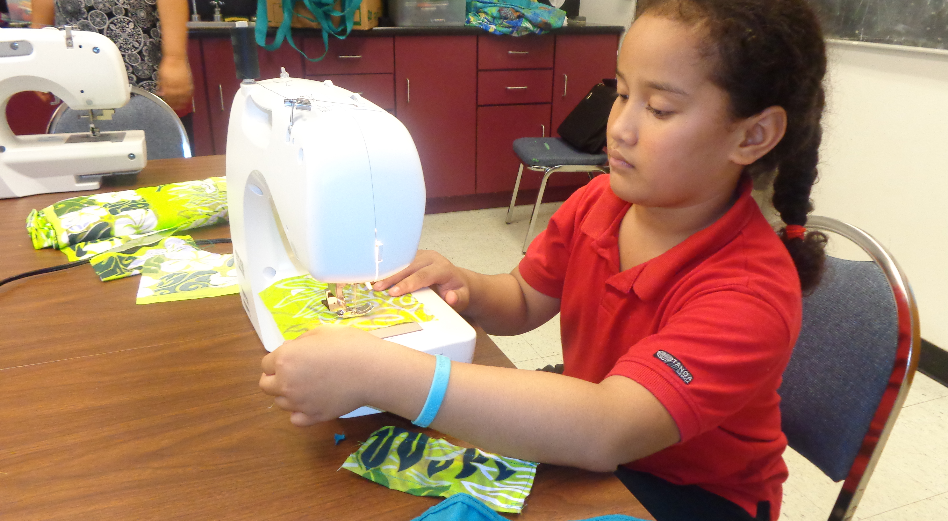
Taking the University to the People
Notes:
No high school to Bachelor of Teacher Education

Slide 7
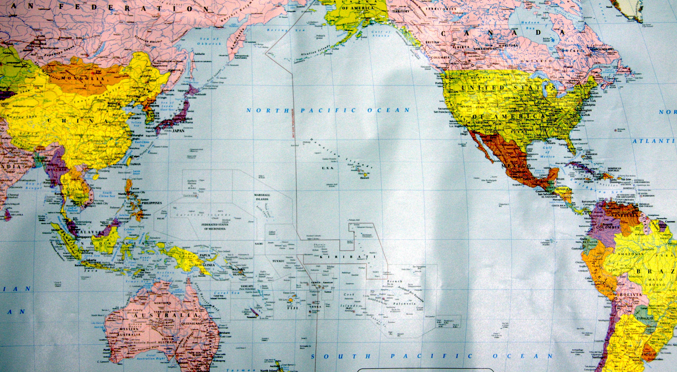
II. Regional Collaborations
Notes:
Across the vast expanse

Slide 8
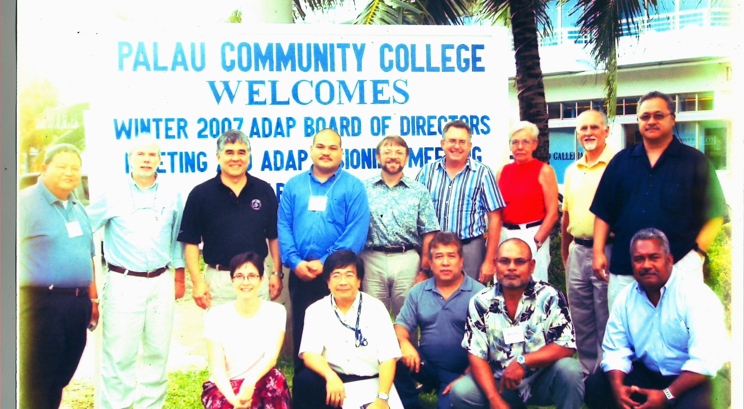
2007 ADAP in Palau
Notes:
23 years
Senator Inouye
Capacity Building: fax machines and early days of the internet;

Slide 9
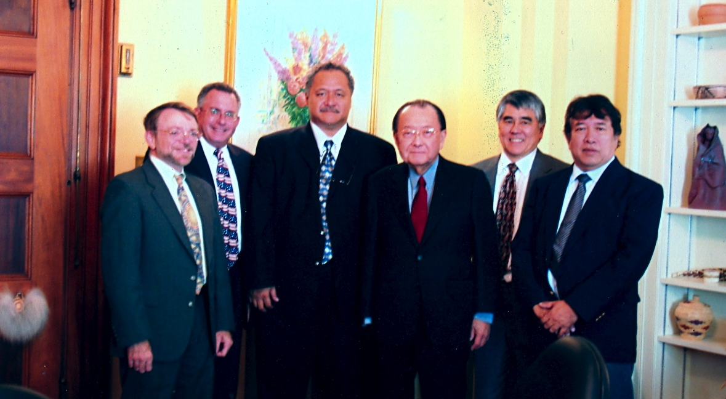
A Voice for the Pacific
Notes:
NIFA Policy Boards (

Slide 10
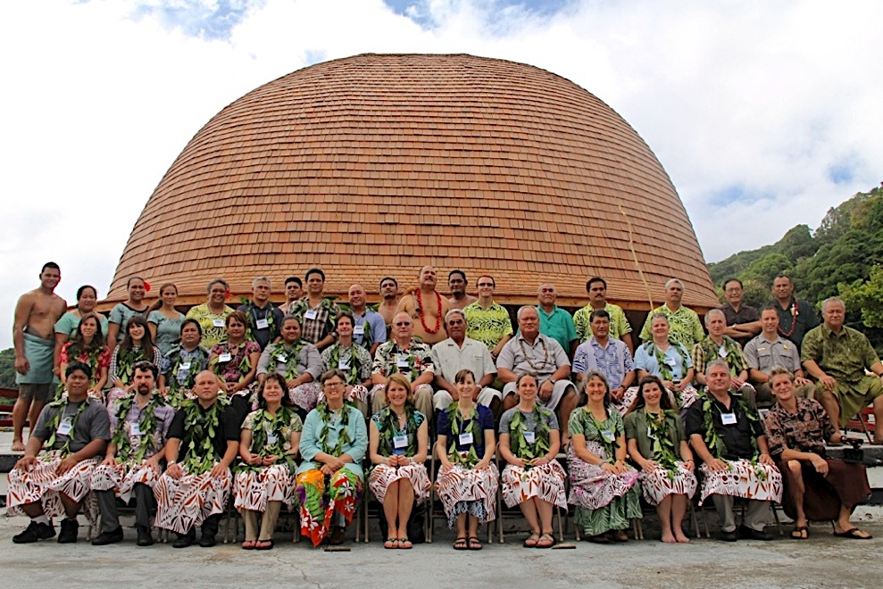
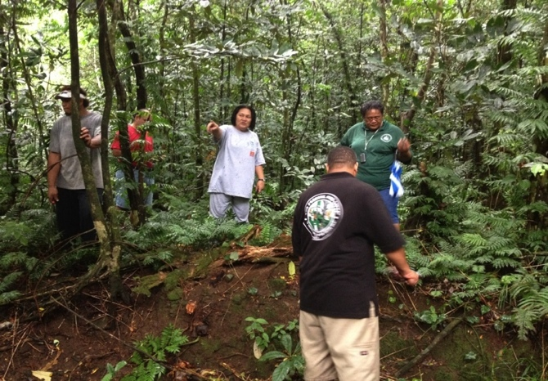
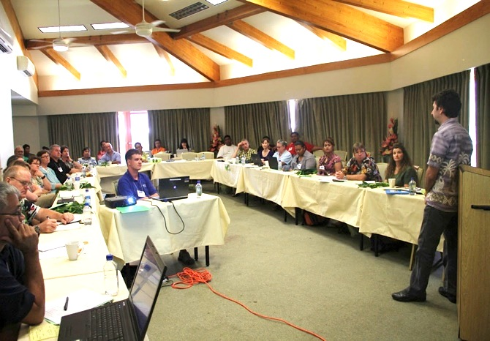
March 2014: Pacific Islands Forestry Committee
Notes:
SIGNED MOU: The Committee consists of foresters from American Samoa, the Commonwealth of Northern Mariana Islands (CNMI), Guam, Hawaii, the Federated States of Micronesia (FSM), the Republic of the Marshall Islands, and the Republic of Palau — all of whom fall under Region #5 of the U.S. National Forest Service.
American Samoa leads the Pacific for the eradication of the invasive tamaligi palagi (Falcataria moluccana) and the Panama rubber tree (Castilla elastica), which crowd out valuable native
Samoan forest species like ifilele (Intsia bijuga).
So far in American Samoa has treated 2,800 acres and eradicated over 8,000 invasive trees.

Slide 11
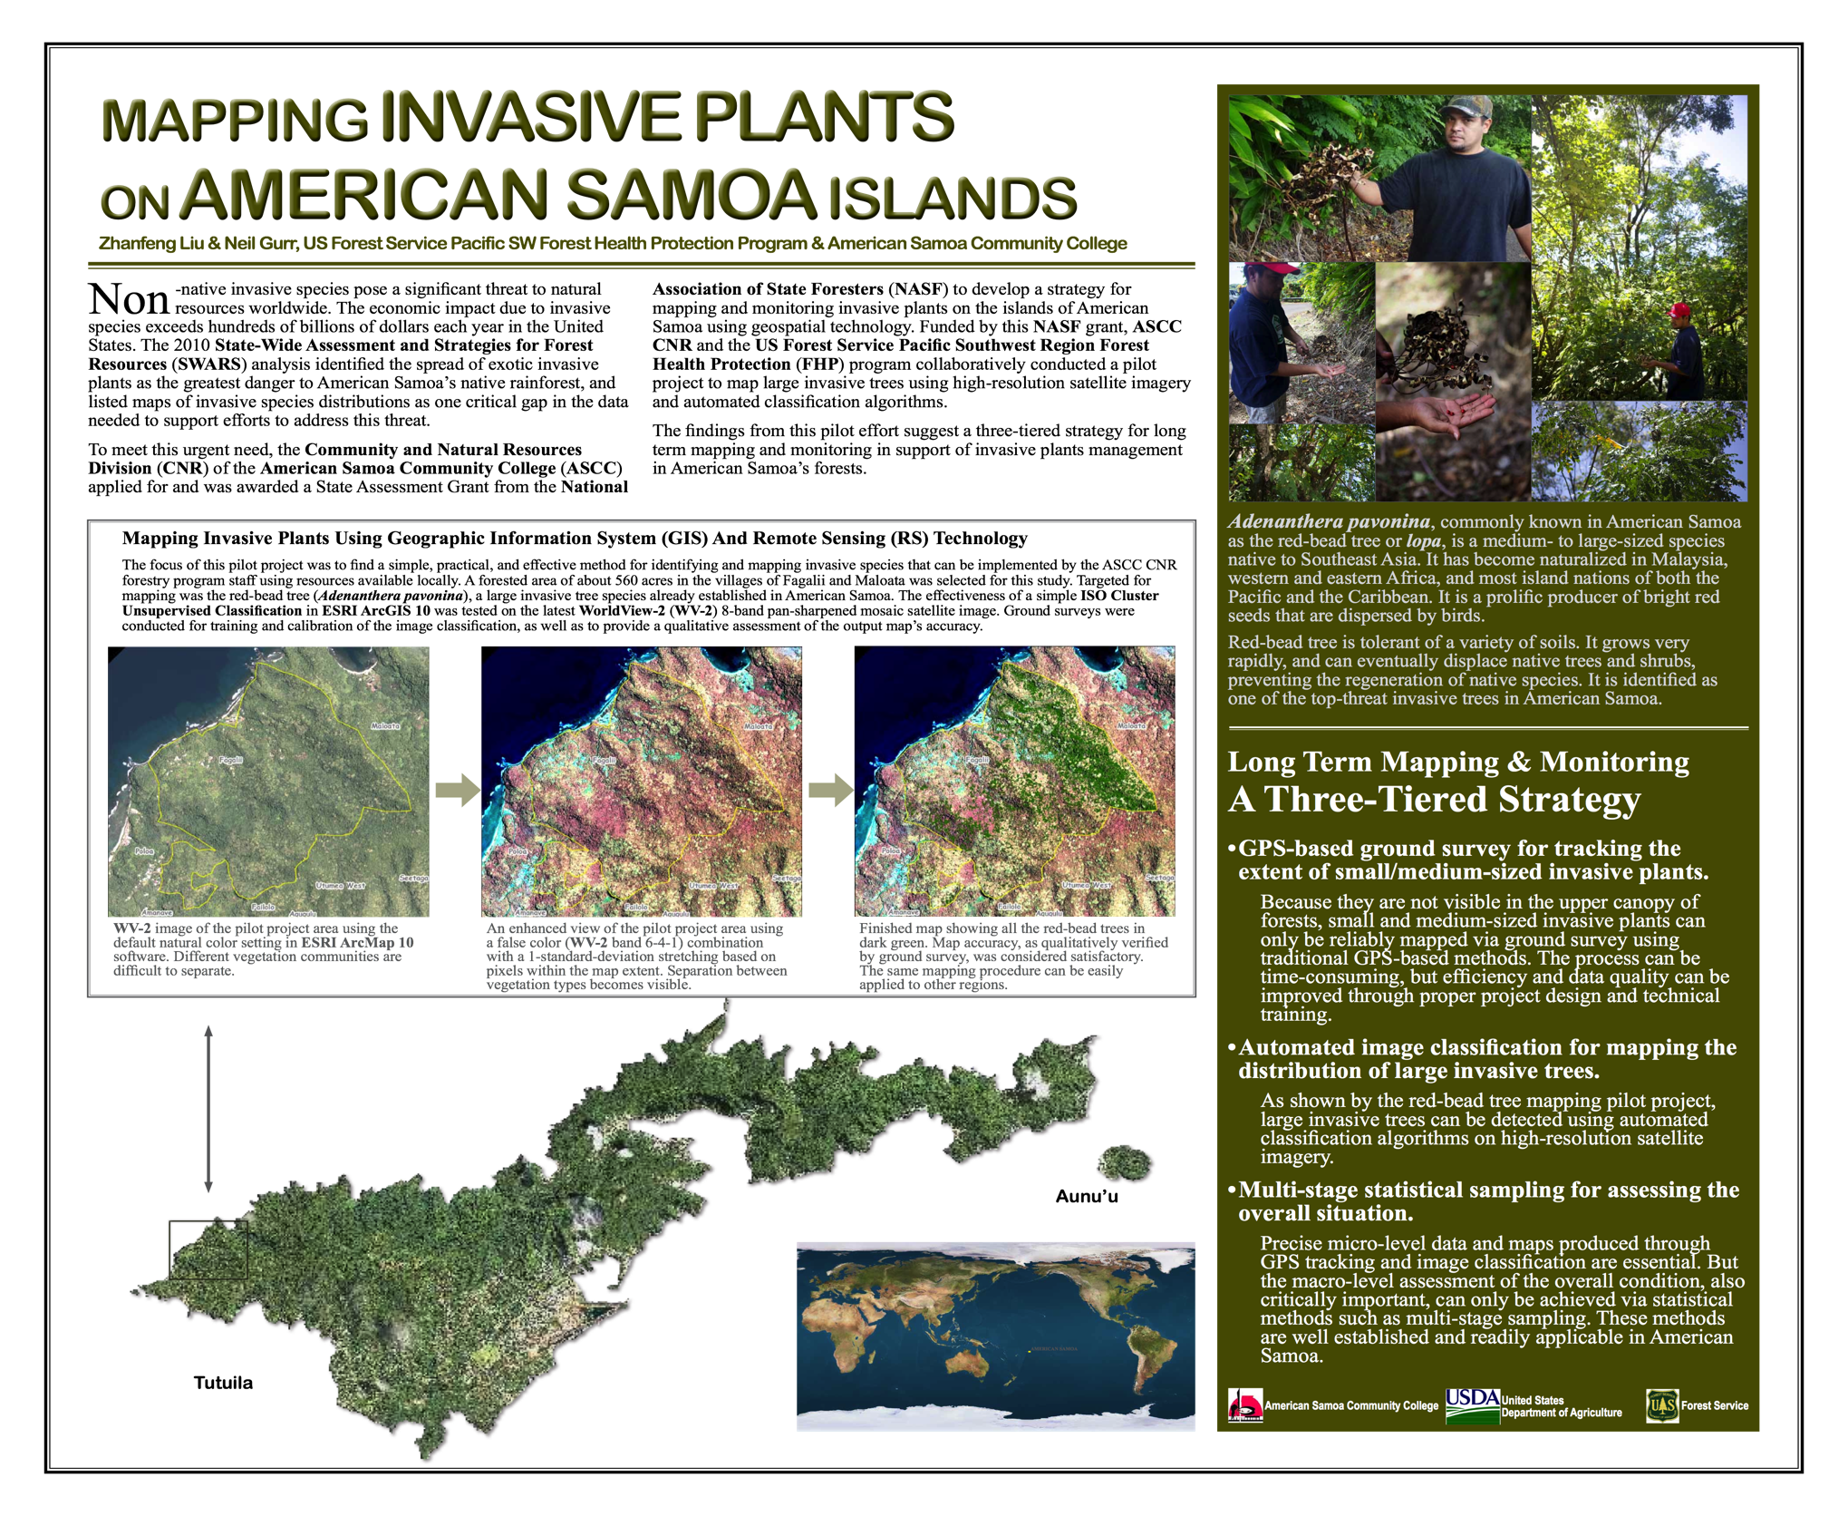
Notes:
Bio-Security
Capacity Building: GIS Specialist

Slide 12

C H L
CHILDREN’S
HEALTHY
LIVING
Notes:
NCD rates
Childhood Obesity booklet

Slide 13
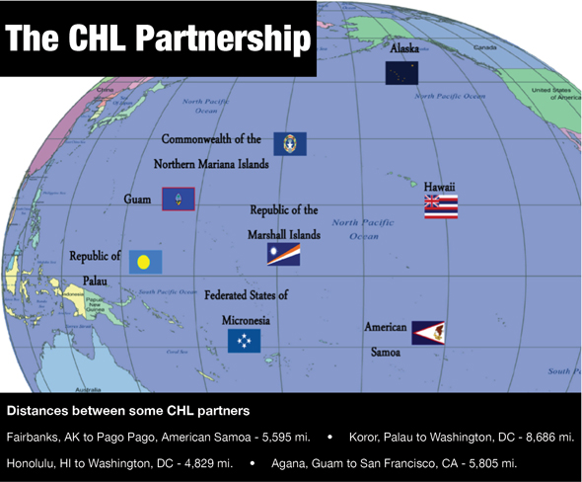

Slide 14
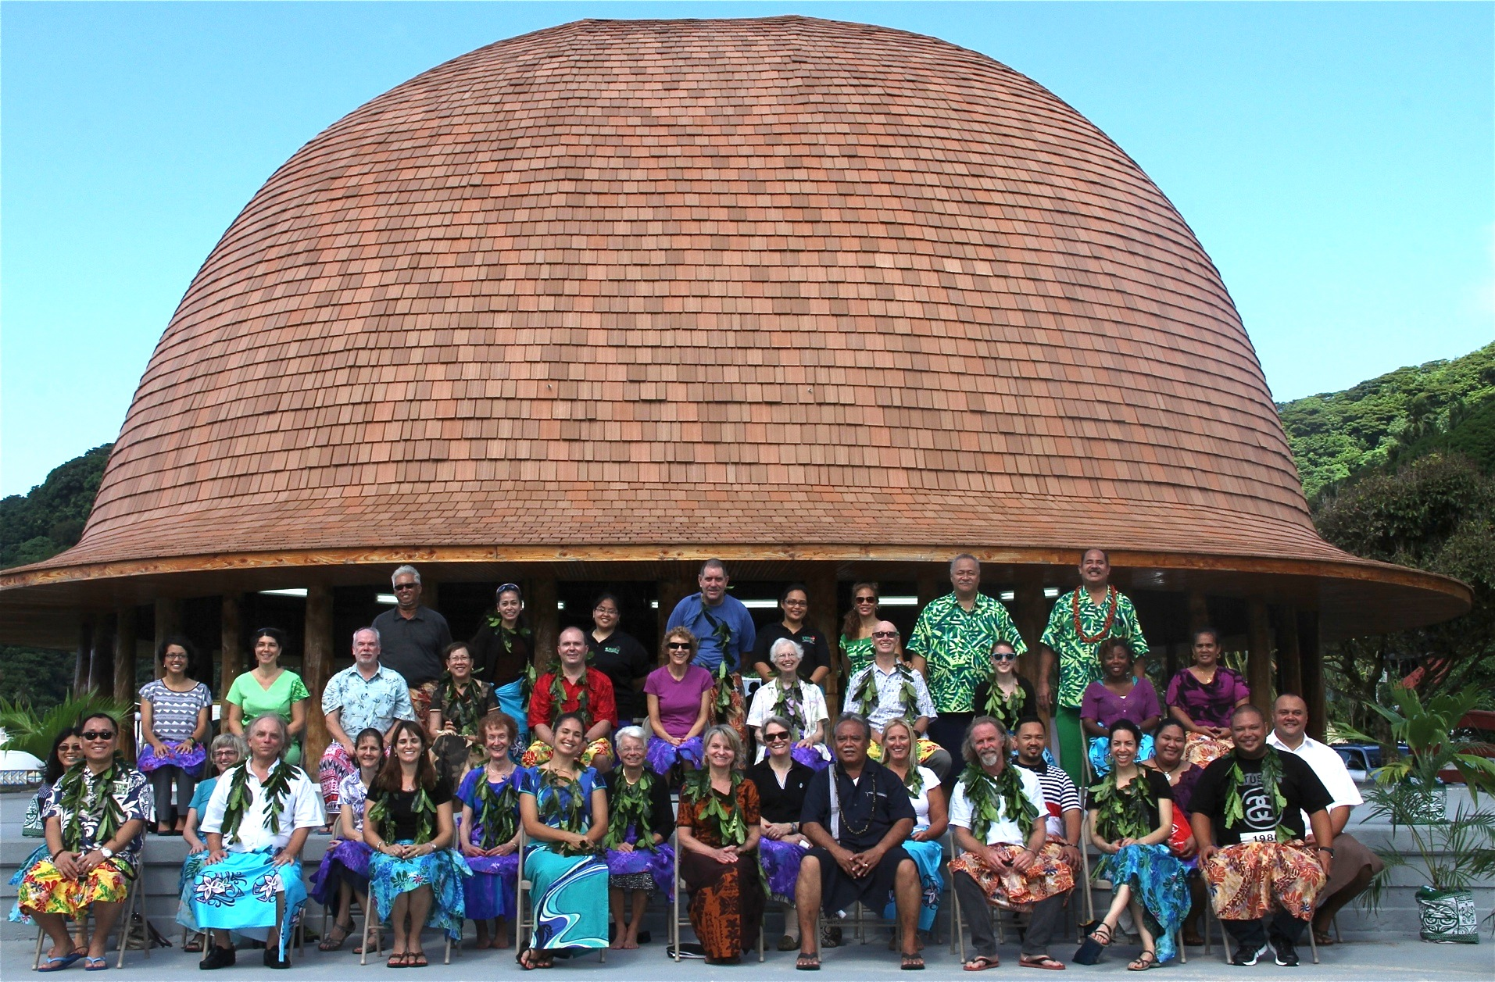
June 2014: Children’s Healthy Living
Notes:
The Children’s Healthy Living Program for Remote Underserved Minority Populations in the Pacific Region (CHL) is a partnership among remote Pacific states and other jurisdictions of the US: Alaska, American Samoa, Commonwealth of the Northern Mariana Islands, Guam, Federated States of Micronesia, Hawaii, Republic of Palau, and the Republic of the Marshall Islands. All jurisdictions have US Land Grant Colleges, which have united in the Pacific Land Grant Alliance (PLGA).
With no US National Nutrition monitoring (e.g, NHANES) in these jurisdictions, not even in the states Alaska and Hawaii, the information we attain through CHL will guide future children’s obesity prevention programs and policies.
The goal of this Food and Agricultural Science Enhancement (FASE) Coordinated Agricultural Program (CAP) among Pacific Region USDA-defined Experimental Program for Stimulating Competitive Research (EPSCoR) states/jurisdictions is to build social/cultural, physical/built, and political/economic environments that will promote active play and intake of healthy food to prevent young child obesity in the Pacific Region. To do this, CHL will engage the community, and focus on capacity building and sustainable environmental change. CHL will serve as a model for other regions with remote underserved Native populations at risk for obesity.

Slide 15
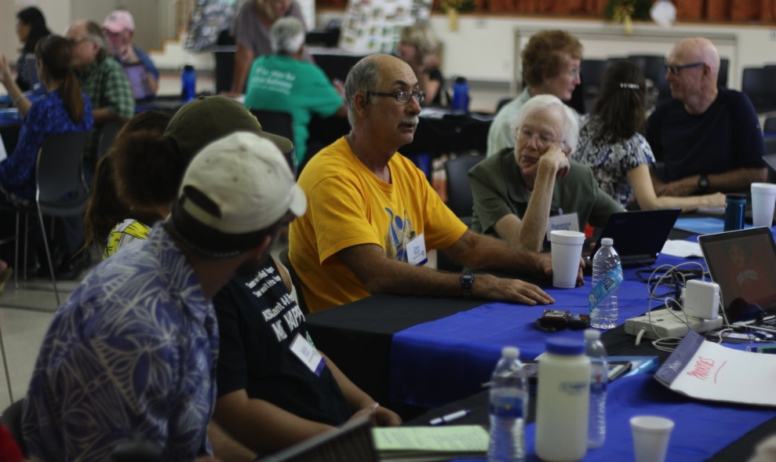
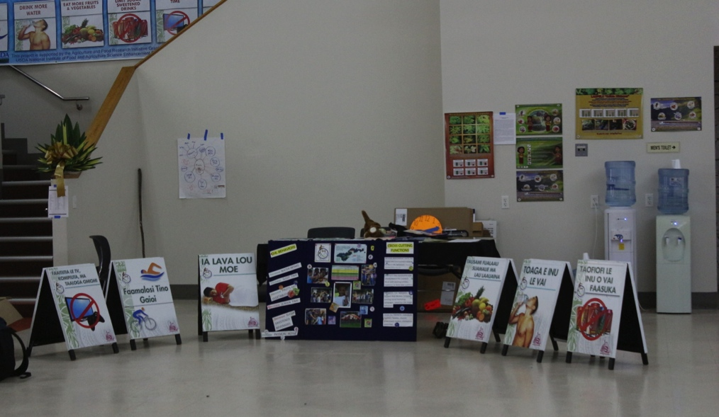
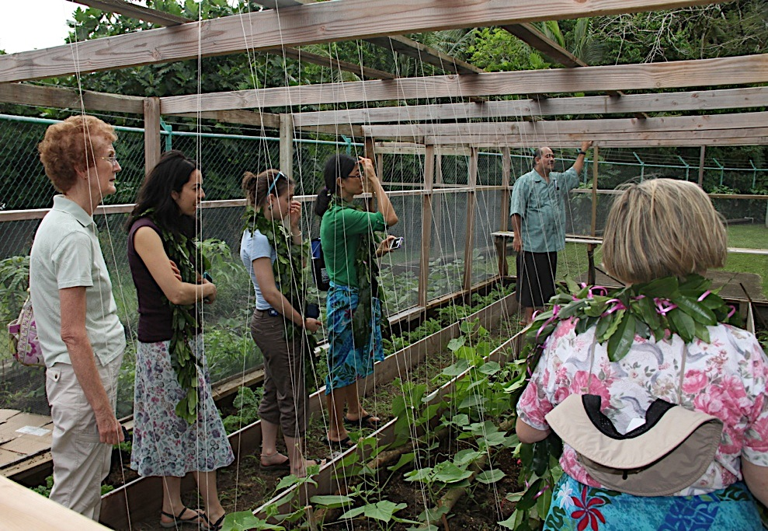
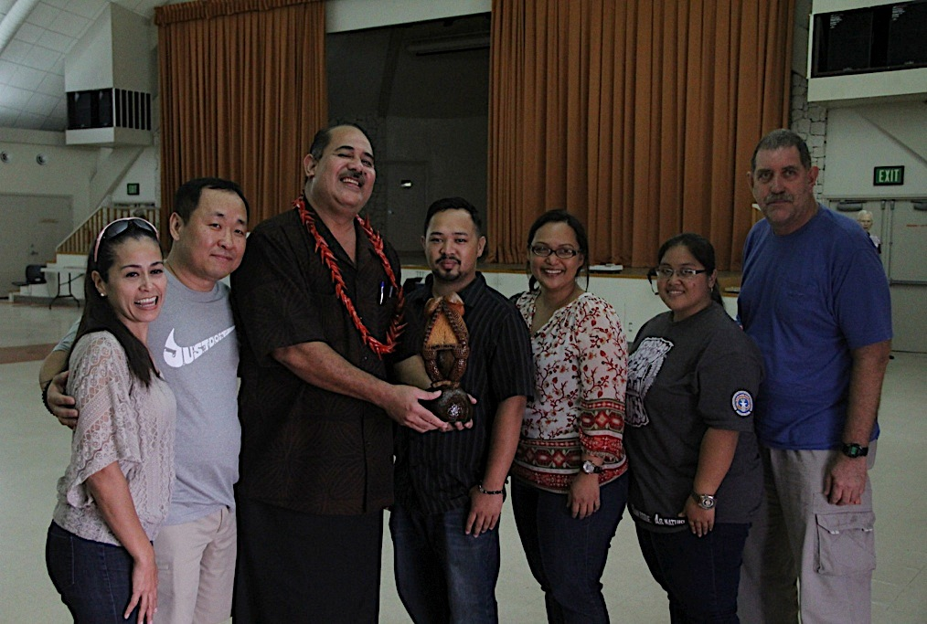
CHL Annual Meeting
Notes:
CHL Conference

Slide 16
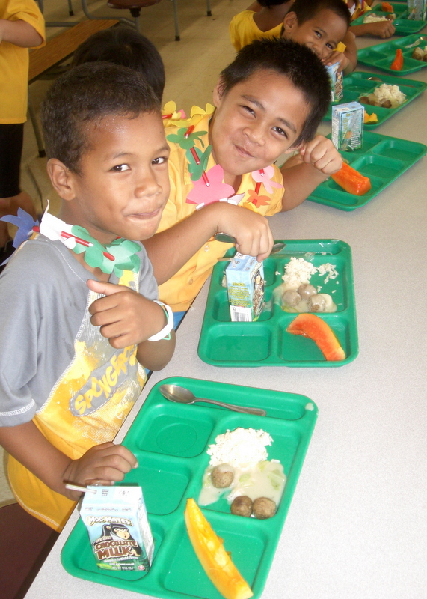
CHL Mission
… to build and sustain a healthy food and physical environment to help maintain healthy weight and prevent obesity among young children in the Pacific region
Tafuna Elementary, American Samoa, April 2013
Notes:
6 messages: less sugar drink/more water; less TV more sleep; more movement & fruits & vegies.

Slide 17
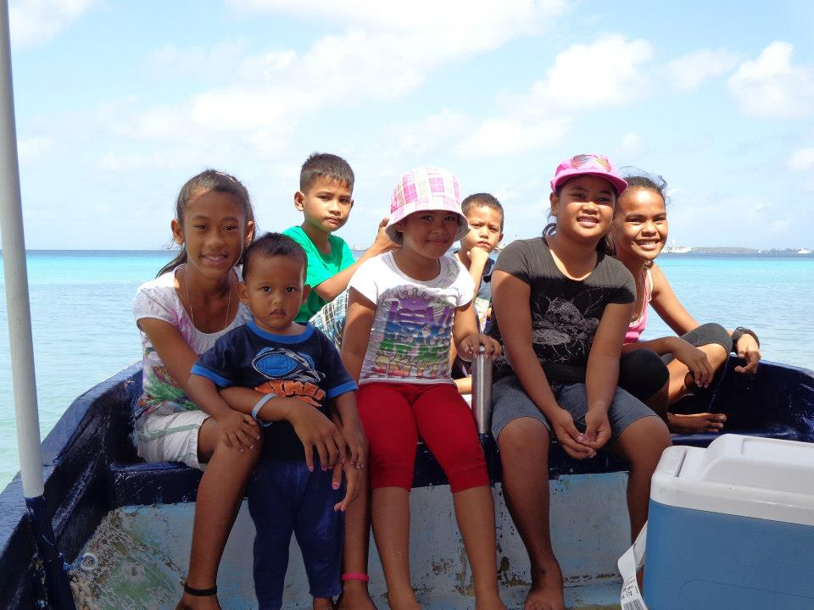
CHL Vision
We envision sustainable community-based systems and environments to raise healthy children in the Pacific Region
Children from the Republic of the Marshall Islands

Slide 18
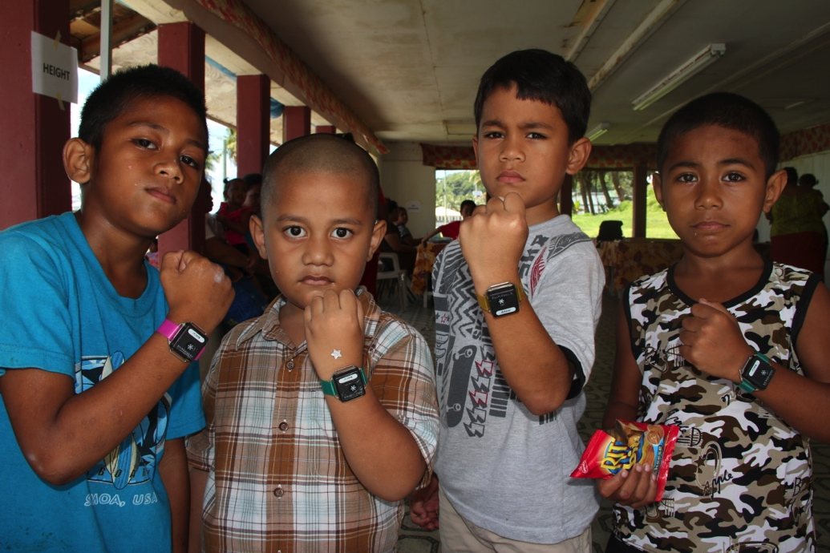
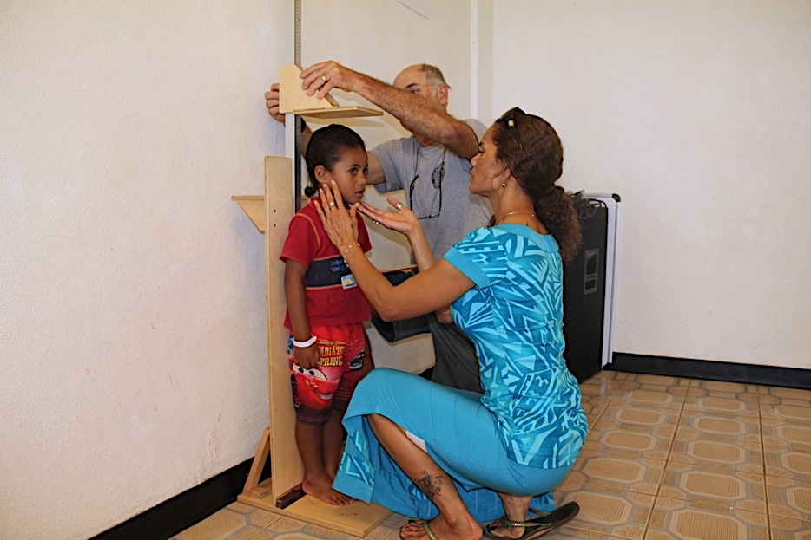
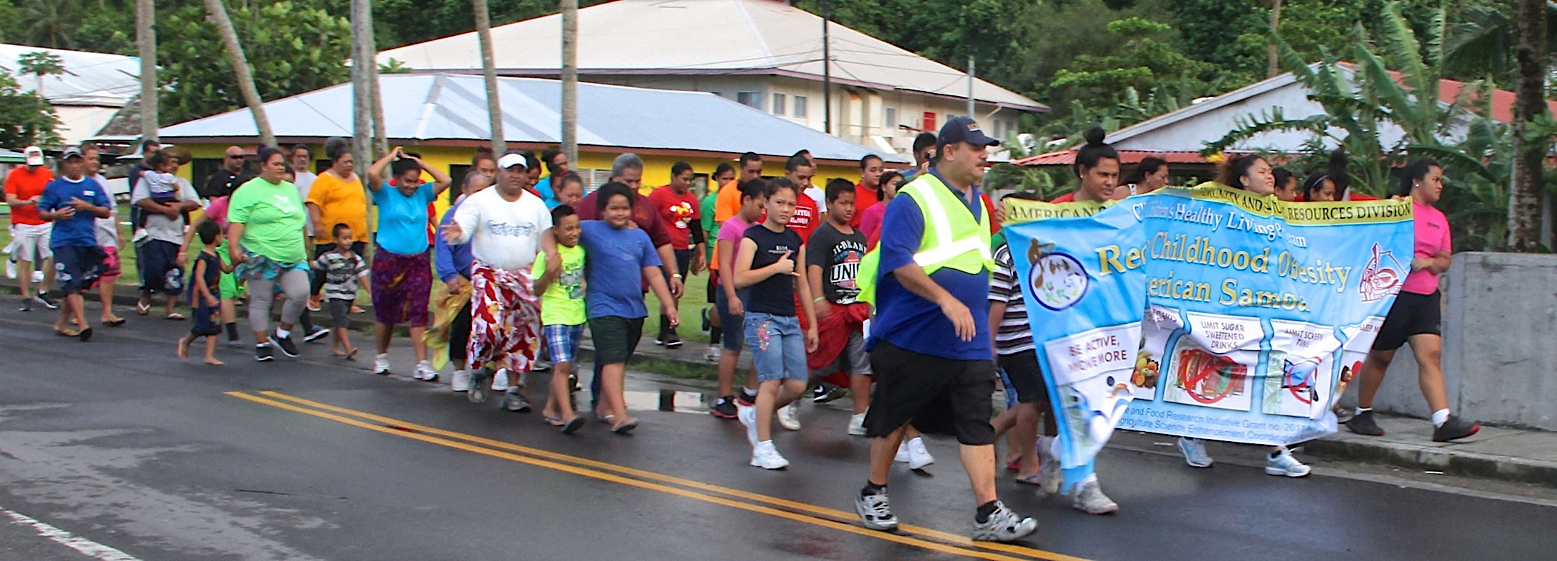
Notes:
Moving into year 4 of 5 year grant

Slide 19
CariPac
… formed as a consortium to help address the challenges of providing food and agricultural education
to college and university students
in the Caribbean and Pacific Islands.
Notes:
During the past 8 years, various institutions had the opportunity to host the CariPac Summer Internship program. Agriculture students from ASCC participated as interns to Puerto Rico, Guam, Saipan and most recently, Virgin Islands. In June 2015, American Samoa will be playing host for the first time.
In 2014, USDA NIFA mandated that each institution in the insular areas apply individually instead of a consortium. In June, we received the good news that ASCC has received funding, with significant increases in both the Resident Instruction and Distance Education grants. We received $159,143 for Resident Instruction and $128,000 for Distance Education – a total of $287,143. Official announcement is pending on administrative paperwork requirements that are being processed at the moment.

Slide 20
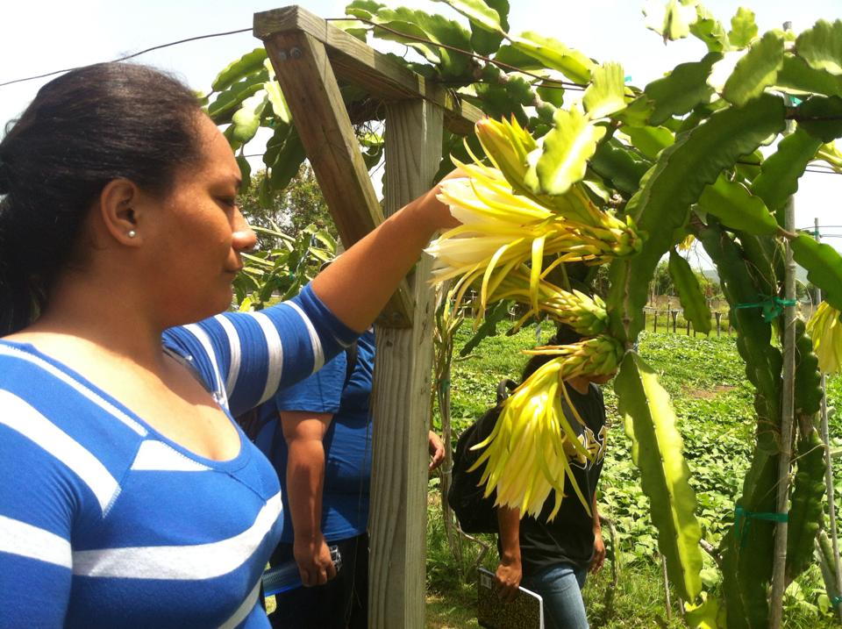
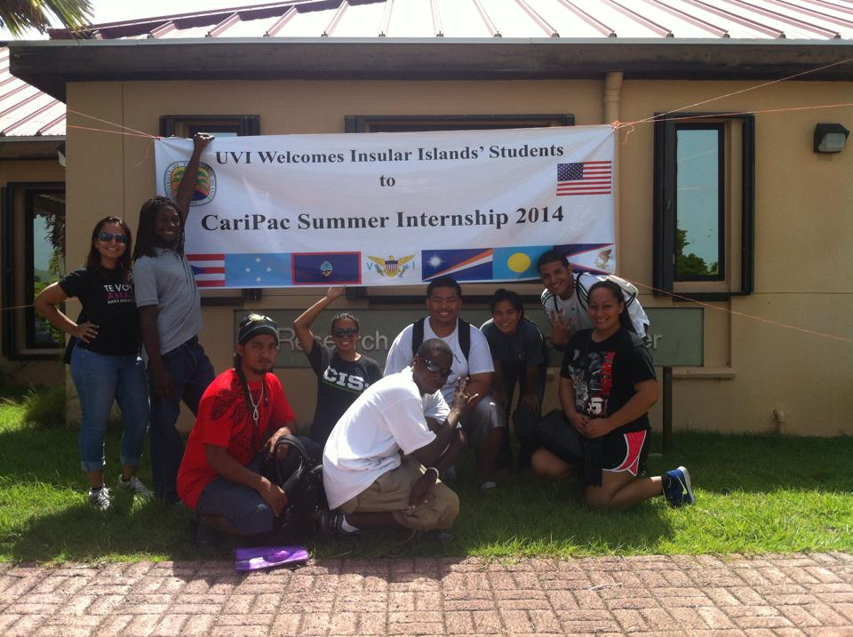
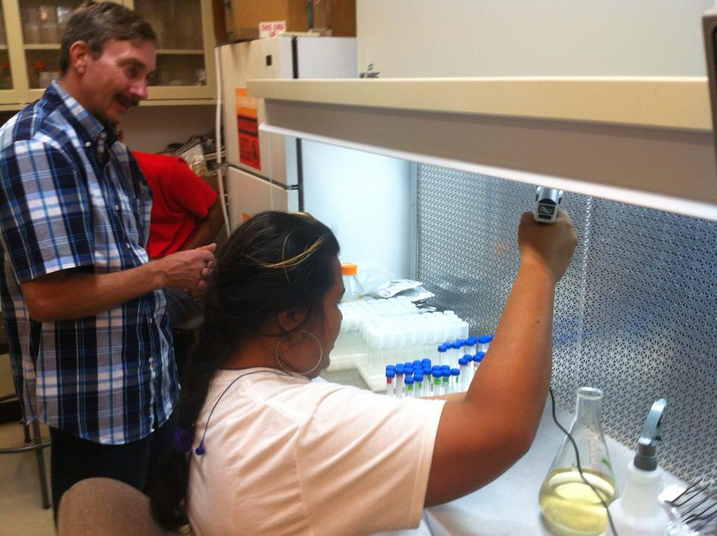
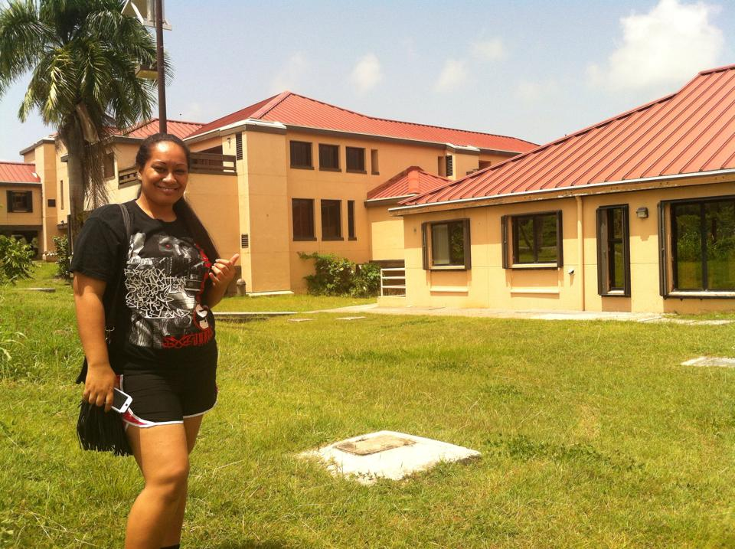
Notes:
Recent CariPac Interns at the University of the Virgin Islands (2014); Guam; Northern Marianas, Puerto Rico
Distance Ed too.

Slide 21
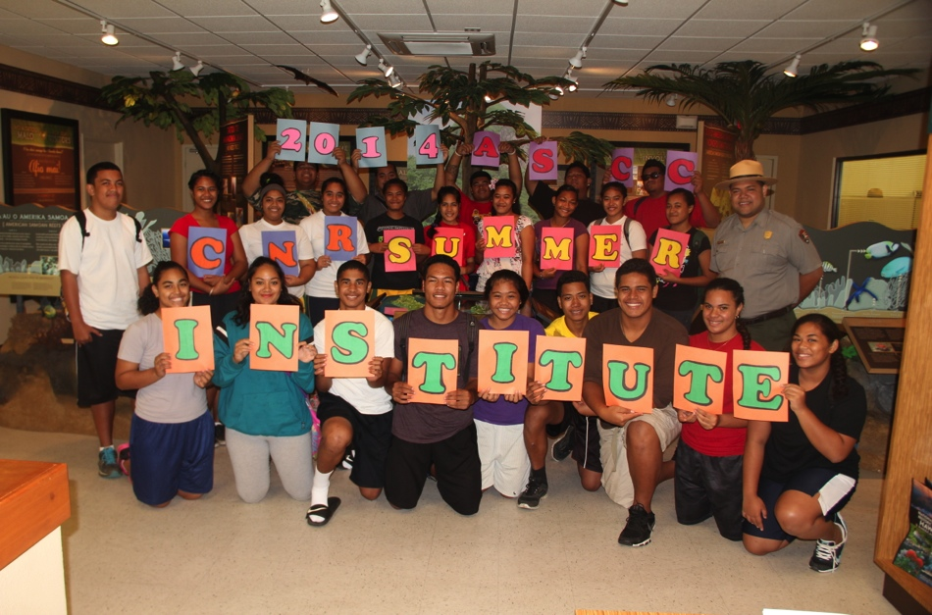
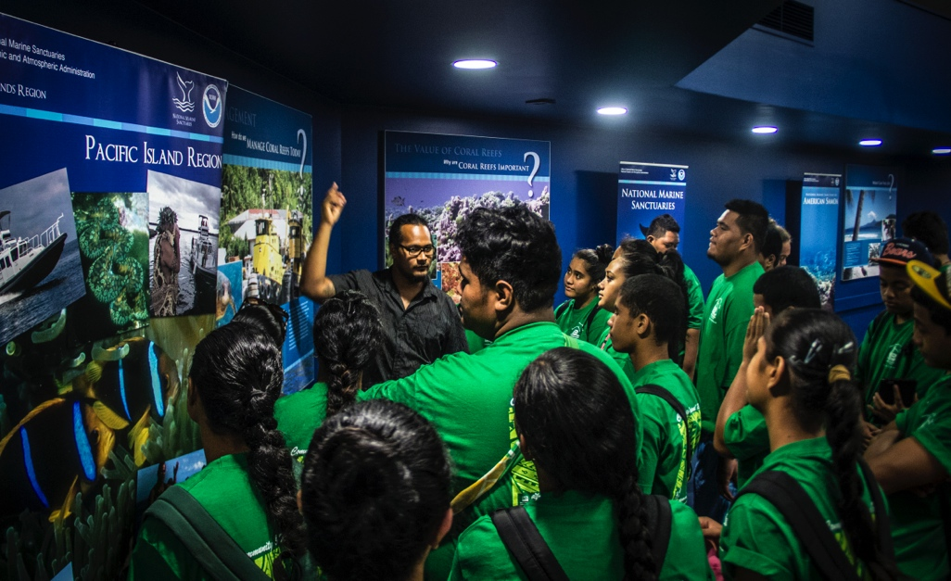
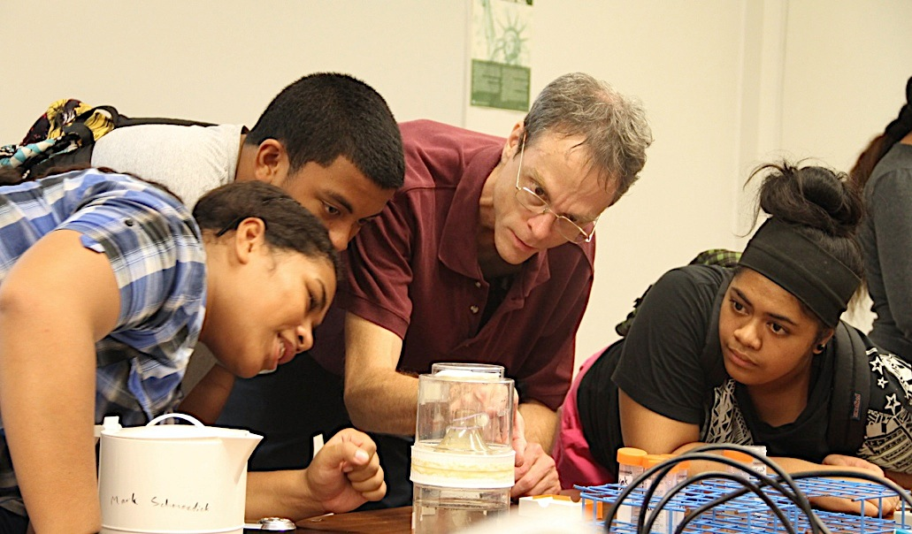
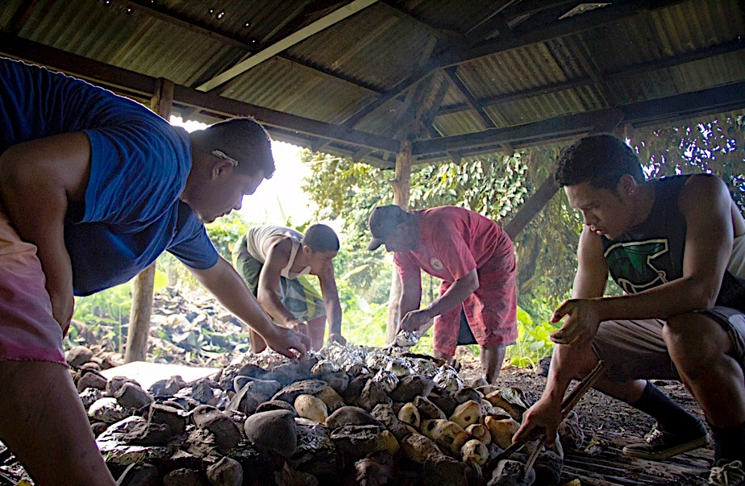
Summer Institute
Notes:
National Park
Ocean Center
Mark and Mosquitos
Umu

Slide 22
III. Local Priorities
Food Security
Wellness
Notes:
FDA Definition
Resilient People with Fragile Eco-Systems

Slide 23

We are “Micro-States”.
Geographic isolation
Price of oil
Limited opportunities to expand export earnings
Declining land available for agriculture
Dependency on imported food
High Food Prices
Non-Communicable Chronic Diseases
Population Pressures
Natural Disasters
Climate Change
Notes:
Bjur and Zommordian – Microstates
SPC
Food Security Conference
NIFA priorities
New Biology

Slide 24
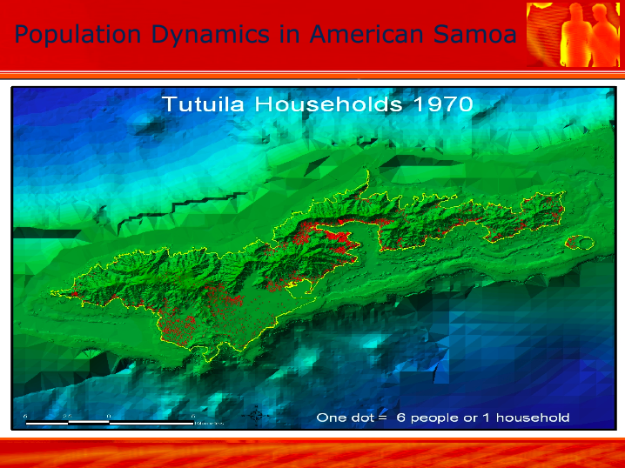
Notes:
Partnership with DOC:
Carrying Capacity
Make up our key land resources. Not to forget our marine resources.
The issue of deforestation and the destruction of our native genetic resources
Must be included in a comprehensive discussions of resources.

Slide 25
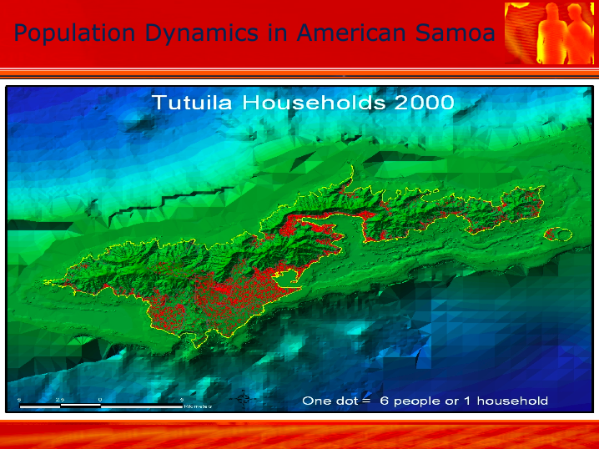

Slide 26
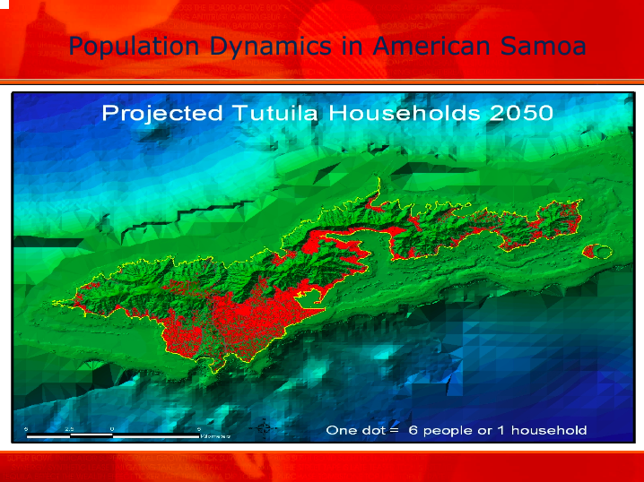

Slide 27
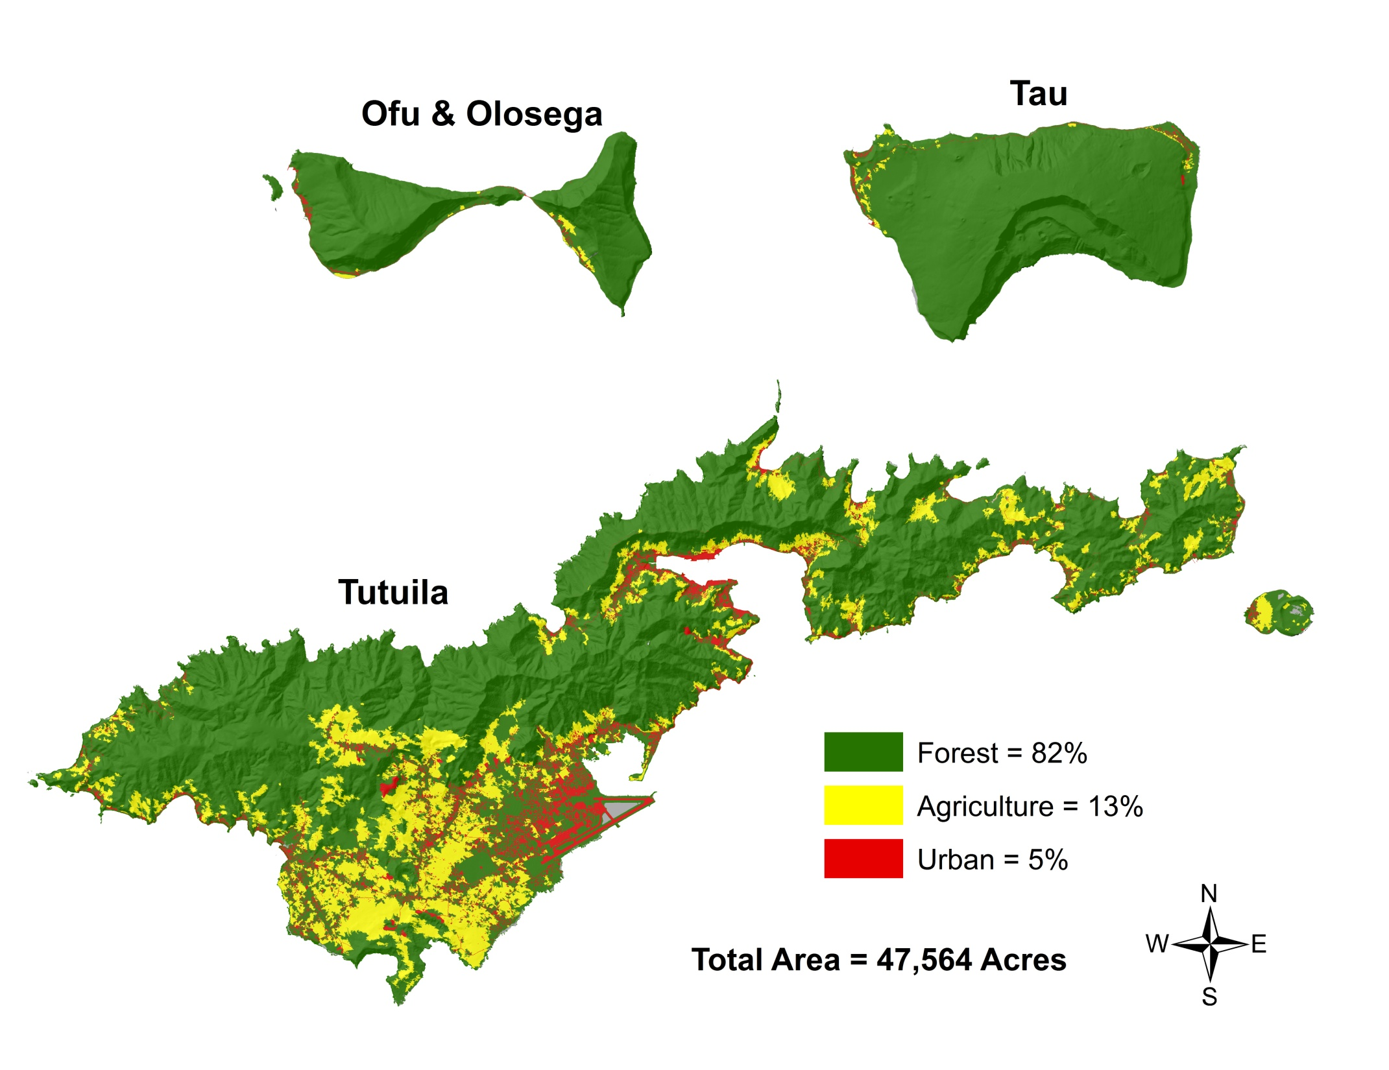
Notes:
Foundations: Land Use

Slide 28
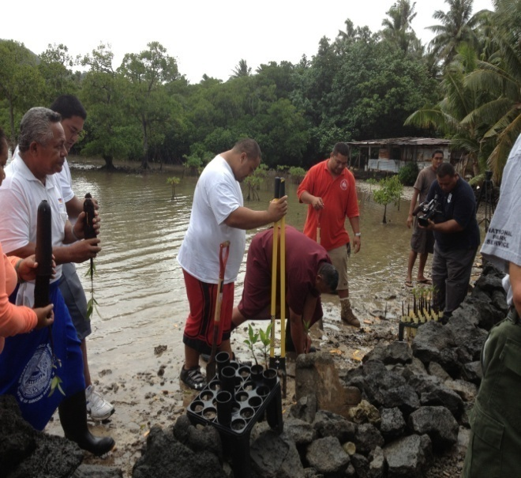
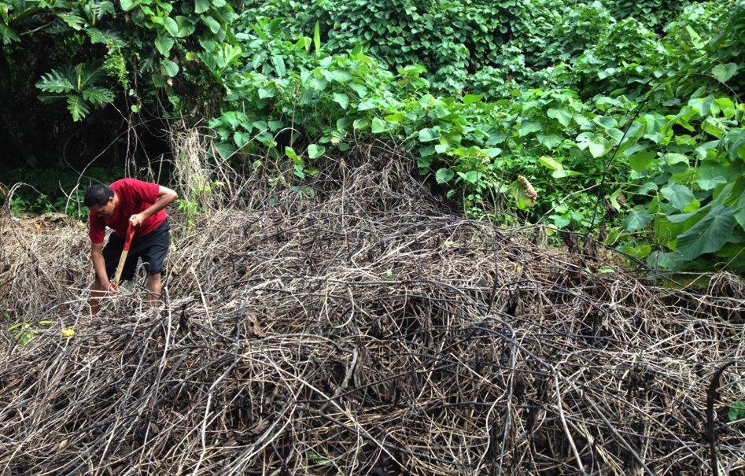
Natural Resources: Forestry
… support beautification, coastal stabilization, traditional forestry practices, and sustainable use of natural resources.
… forestry education and management of forests and tree resources, all with respect to the culture and environment…
Notes:
Ecosystem: Foundations of Food Security in land, water, air
If we are good to the forests, the forests will be good to us.
2009 Tsunami: Plant Trees for Hope

Slide 29
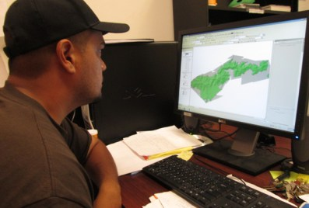
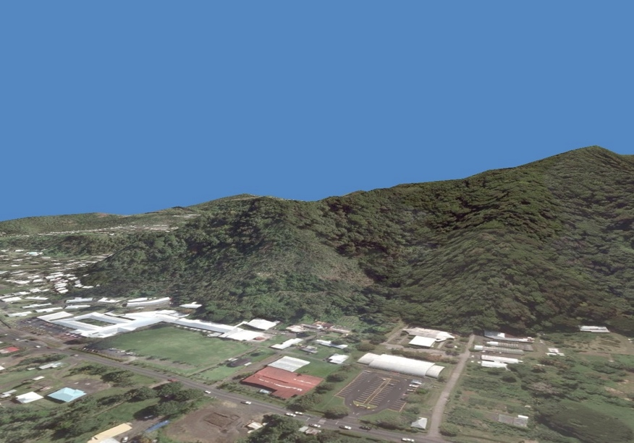
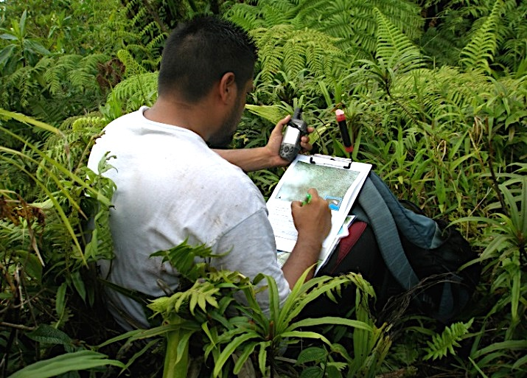
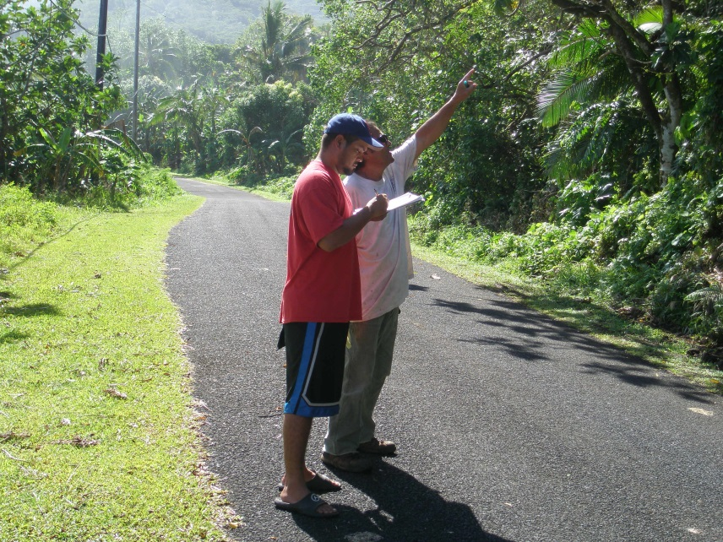
GIS Mapping and Fieldwork

Slide 30
AGRICULTURE EXTENSION
Provide research-based agricultural information
Promotes safety to the community
Farm and school visitations

Slide 31
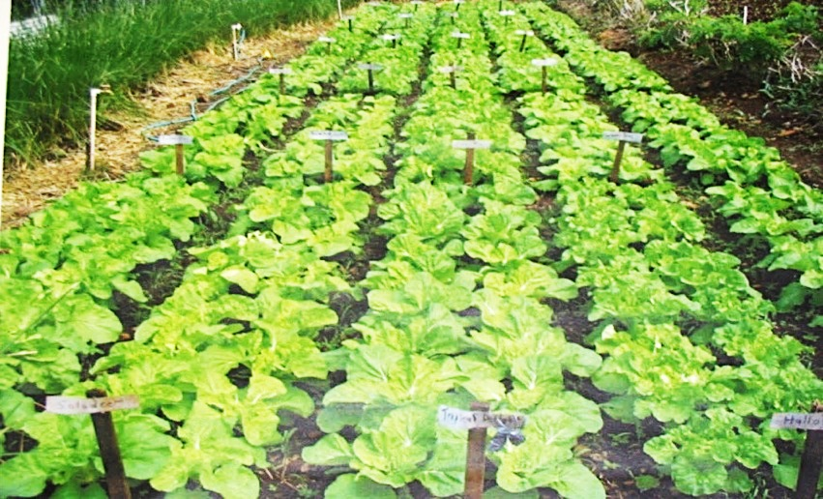
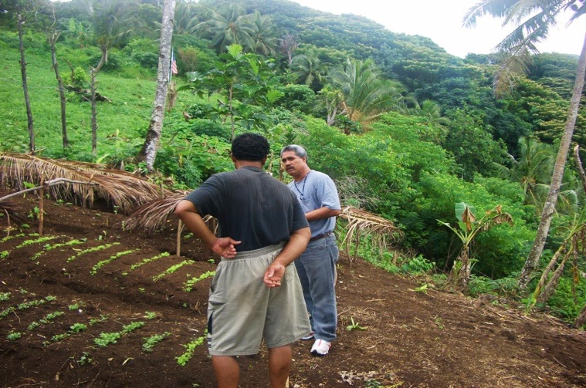
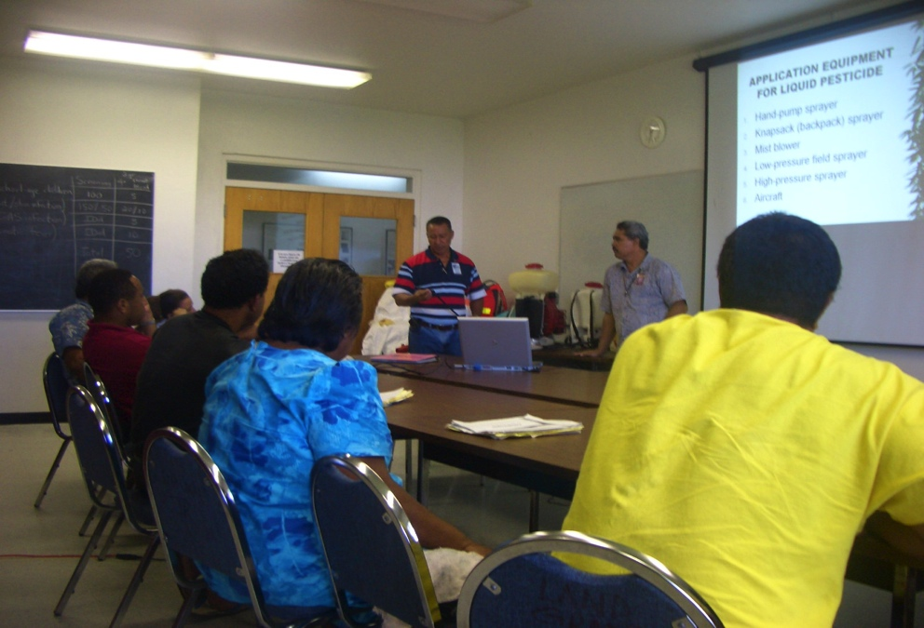
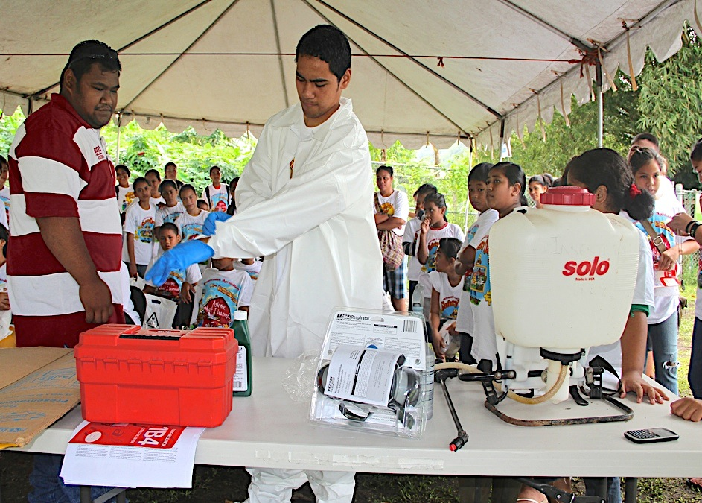
Vegetable Trials
Farm Visitations
Pesticide Applicator Training
Farm Safety training
Notes:
Taro & Banana
VEGIES
SPECTROMETER to test pesticide mis-use

Slide 32
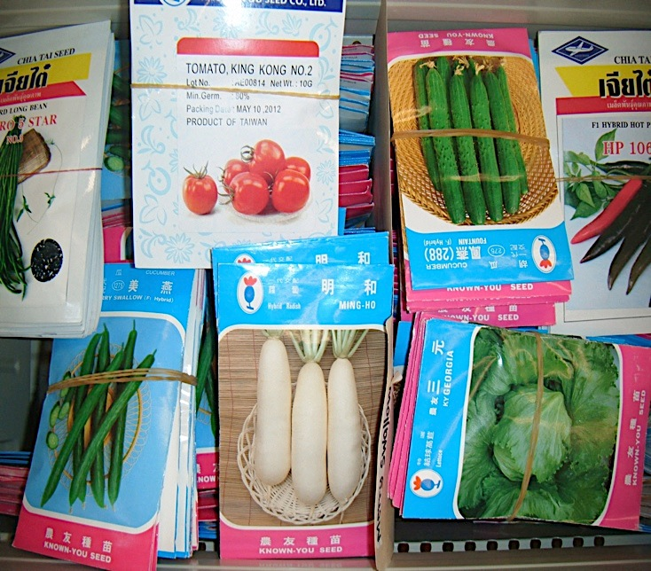
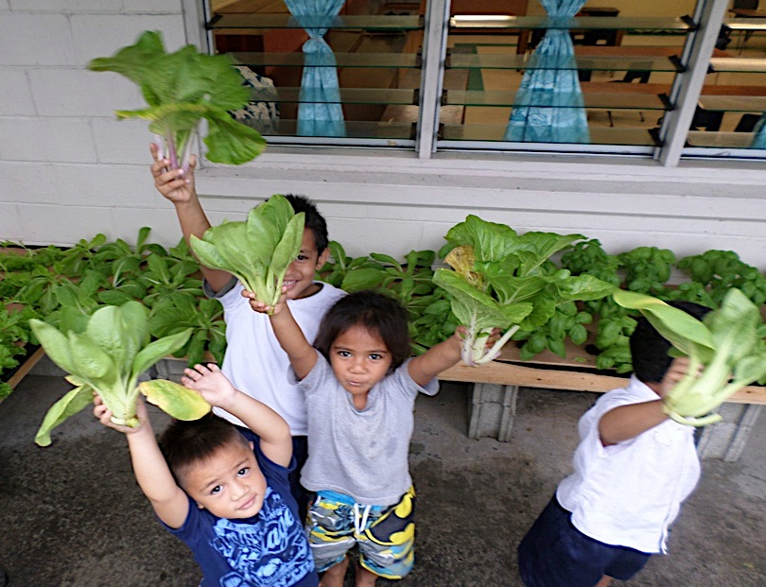
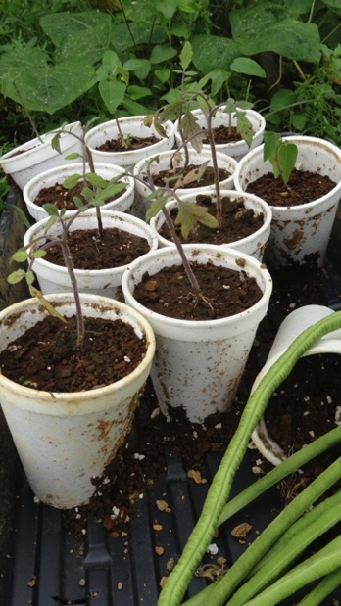
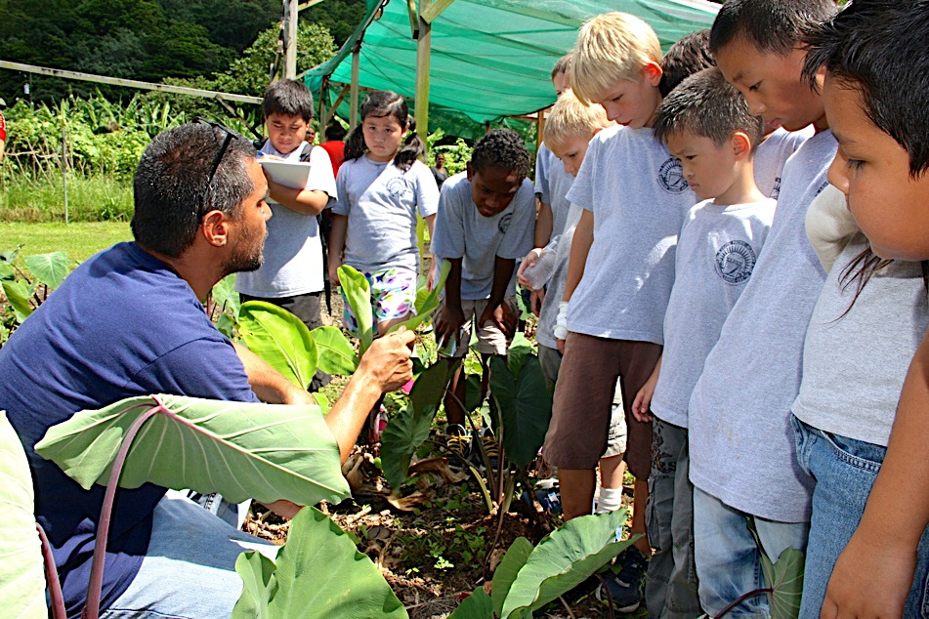
Seed Sales and seedling distribution
Hydroponics
Farmer Training
School Tours

Slide 33
Horticulture Research
better utilization of locally available organic waste and by-products to reduce importation of farm inputs.
…of coconut husk and compost from worms and dry litter piggeries
new varieties of nutritious, high yielding and disease resistant food crops for the tropics, such as taro, sweet potato greens and edible hibiscus.
Notes:
Finding the right model of ag development

Slide 34
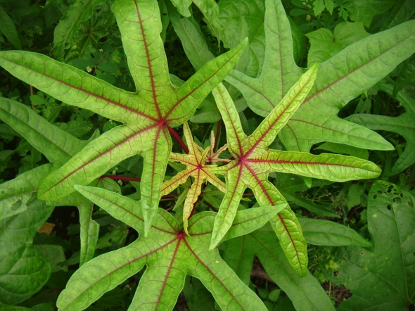
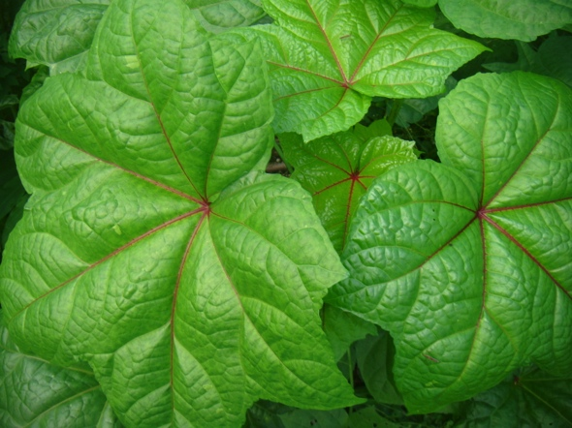
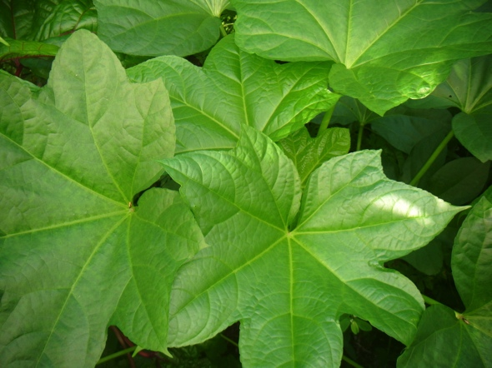
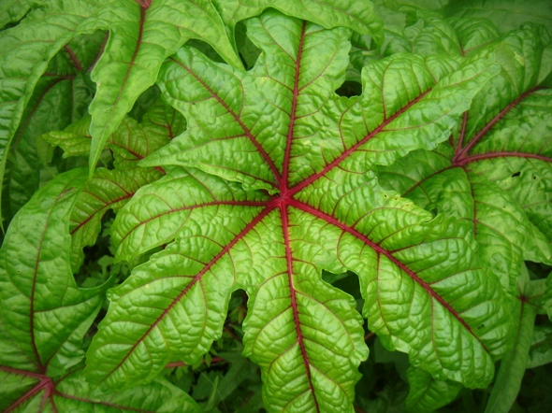


Edible Hibiscus (laupele)

Slide 35




Sweet Potato Leaves
Notes:
Sweet potato vine tips and tender leaves can be eaten as a vegetable. Sweet potato leaves are very easy to grow in American Samoa. Sweet potato leaves are very nutritious, comparable to spinach in nutritional value. Sweet potato leaves are a good source of protein, fiber, vitamin B, beta carotene, iron, calcium, potassium and zinc. Besides being very nutritious, research from The University of Arkansas at Pine Bluff has shown that sweet potato leaves, especially the purple leaves, contain compounds that have significant medicinal value.

Slide 36
Fruits for Life Greenhouse
… serves as
a germ-plasm for local farmers and interested community members
a life-lab for ASCC students and community members
promotes the production of locally grown fruit trees and nuts to improve nutrition and health.
Notes:
Adam and Eve

Slide 37




Notes:
Greenhouse
Grafting
Watering mint

Slide 38
Dry-litter System (2009)
to demonstrate how to properly manage animal wastes
be in compliance with EPA laws
helped prevent the spread of leptospirosis.
Notes:
Leptospirosis Deaths

Slide 39




Notes:
Started on chickens more
Rabbits

Slide 40
Aquaculture Program
Promotes aquaculture and aquaponics
Maintains four different aquaculture and aquaponics systems
Provides technical support to aquafarmers
Hosts over two thousand visitors a year the the Center for Sustainable Integrated Agriculture and Aquaculture
Provides machinery and materials to make tilapia feed, free of charge to aquafarmers

Slide 41





Slide 42
Entomology Lab
Provide … appropriate, timely, science-based entomological information through research and extension.
Integrated pest management
Biological control
Mosquito control
Plant clinic - diagnostics
Biosecurity & pest surveillance
Exotic invasive species
Honey bees
Samoan swallowtail conservation

Slide 43



Biological control of Seychelles scale insect
Mosquito control research for filariasis elimination and dengue prevention
Biosecurity: exotic invasive pest surveillance

Slide 44



Samoan Swallowtail Conservation

Slide 45
Plant Pathology
… conducts basic and applied plant pathology research that emphasizes an integrated approach to secure the food supply of American Samoa, while preserving its natural ecosystems.
The goal is to ensure sustainable production of staple crops (e.g., taro, banana, breadfruit, coconut) and other tropical crops of American Samoa.
Notes:
Seeking FDA Accreditation:
Spectrometer, Biolog, DNA Sequencing; Water Quality Testing

Slide 46





Slide 47
STEP-UP Program
Short-Term Research Experience for Underrepresented Persons
Funded by National Institutes of Health
Coordinated in the Pacific through University of Hawaii medical school
Individualized research training for high school students with scientist mentors

Slide 48





Slide 49




III. Priority: Wellness

Slide 50
Wellness Center
Nutrition
Exercise
EFNEP
CHL
Health Communications
Instruction
Food Policy
Diagnostics
Stress Management

Slide 51


Expanded Food and Nutrition Education Program
Helps limited income families and youth to improve their diets and to increase their skills in preparing nutritious and economical meals.

Slide 52

TOGIOLA T.A. TULAFONO
Governor
FAOA A. SUNIA
Lieutenant Governor
Telephone: (684) 633-4116
Fax: (684) 633-2269
go@americansamoa.gov
OFFICE OF THE GOVERNOR
American Samoa
EXECUTIVE ORDER NO.011-2009
AN ORDER ESTABLISHING THE AMERICAN SAMOA FOOD POLICY COUNCIL, PROVIDING FOR ITS PURPOSE, DUTIES, RESPONSIBILITIES AND MEMBERSHIP
Preamble
WHEREAS, “ASIASIGA: a Conference on Food Security in American Samoa” was held on February 18-19, 2009 at Lee Auditorium in American Samoa;
TOGIOLA T.A. TULAFONO
Governor
FAOA A. SUNIA
Lieutenant Governor
OFFICE OF THE GOVERNOR
American Samoa
EXECUTIVE ORDER NO.011-2009
AN ORDER ESTABLISHING THE AMERICAN SAMOA FOOD POLICY COUNCIL, PROVIDING FOR ITS PURPOSE, DUTIES, RESPONSIBILITIES AND MEMBERSHIP

Slide 53

IV. The Future
Notes:
1) Motivate Students to Return
2) Will Common Values do us any Good?

Slide 54

Se’i nonoa ane se lipine samasama!
Notes:
Besides being Micro-States, we have in common the US military option
First Deployment to Iraq
Lots of young people did not know why the yellow ribbons or the song
Irony of not being a star on the US flag but dying for it

Slide 55

Slide 86

Slide 56
Operation Military Kids
OMK provides support for military
Youth impacted by the deployment
of a family member.

Slide 57




Notes:
Kite flying
Elei
Polumalu
Planting cabbage

Slide 58
4-H Youth Development
Head
Hands
Heart
Health
Notes:
Tell my Ponape
Translated into Samoan

Slide 59




July 4th: 4-H Youth Day

Slide 60

Notes:
Search for Common Values: Identity,
Disciplining Children.

Slide 61

O le fuata ma lona lou …

Slide 62
Manumanu i le upega
ae le ‘o le naunau i le i’a
Notes:
Le tafa o ata I le taeao
O le faliu o le la I lona tauafiafi?

Slide 63

Acknowledgements:
Seth Galeai
Don Vargo Aufa’i Areta
Pauline Tuitele Tunai A. Peters
Molly Lagai Mary Taufete’e
Dan Helsham Tipi Faalogo
Mary Scanlan Neil Gurr
Ian Gurr Mark Schmaedick
Ndeme Atibalentja Emily Ilaoa
Travis Fleming Rebecca Fiame
Toepo Leiataua Ursula Te’o
Eseta Sua Joyce Peters
Dianne Tarrant Jerry Lefono
Sven Ortquist, Carver

