Slide 1
Tips and Tools for Beginning to Write the ISER
TONI!
BECKY!
CLARE!
By Becky, Tonirose and Clare
Standard 2 Supergroup
(PowerPuff Chicks)

Slide 2
#1 – Create the shell
Tonirose took the entire document and made a shell JUST for Standard 2
We divided up the standards. Becky has the least because she will do a grammar check on all of ours. Clare has the most because she has written an ISER before.

Slide 3
#2 Compare
Compare the old and new side by side and copy and paste from 2012 ISER into the new shell, whenever possible
This is just a GUIDE to what MAY go in that section.

Slide 4
#3 Begin the Writing
Three sections:
Descriptive Summary
Self-Evaluation
Actionable Improvement Plan

Slide 5
Descriptive Summary
Tells what the college does in relation to the standard, gives the facts
-explain
-provide details
-if writing is hard, first list facts
-record sources of evidence
-break into related paragraphs

Slide 6
Deconstruct
All instructional programs, regardless of location or means of delivery, including distance education and correspondence education, are offered in fields of study consistent with the institution’s mission, are appropriate to higher education, and culminate in student attainment of identified student learning outcomes, and achievement of degrees, certificates, employment, or transfer to other higher education programs. (ER 9 and ER 11)
Descriptive Summary
The College’s instructional programs are offered in fields consistent with the institution's mission of workforce development. The College offers XX associate degree programs, xx certificate programs. Program documents are routed through the curriculum process as outlined in the Curriculum Manual (Ev#1). In Section IV. A of the Program Approval Form (Ev#2), authors must state the reason the program should be approved in light of the College’s mission statement.
Authors must also provide student learning outcomes which are reviewed by all signatories to ensure that they are appropriate to higher education. The College uses a two-year assessment cycle to assess programs and ensure that students have attained identified student learning outcomes. As part of this assessment cycle, programs must demonstrate how student learning outcomes will be assessed, identify artifacts, provide criterion for success, collect data and ways to use the results. Assessment plans and reports are uploaded into TracDat, the College’s software blahblah blah.
The College publishes an annual fact book which informs the campus and the community on the number of people have achieved degrees and certificates. The Office of Planning and Development conduct post graduate surveys to determine if graduates continue their education in other institutes of higher education, or are employed in the field.

Slide 7
Self -Evaluation
Tells how the College is doing (good/bad)
-whether or not and to what degree
-institutional evidence in how standard was met (how did you reach the conclusion)

Slide 8
Example
Self-Evaluation
The College adopted XX new programs since 2012, including XX (Ev#3), YY (Ev# 4), ZZ. (Ev# 5). All of these included the reason the programs should be adopted in light of the College’s mission statements. Existing programs at the College must be reviewed and revised within five years of the adoption or the last revision. In the 14th AIAR report (Ev#6), a XX compliance rate for program revision was obtained. The report also indicated that out of XX postsecondary programs, XX% were assessed.
According to the 2015 Factbook, GCC had XX number of graduates – with XX obtaining an Associate degree and XX obtaining a certificate. Follow-up surveys conducted one year after graduation. From the XX who submitted surveys, XX are currently employed in their respective fields, and XX are currently attending a 4-year institution. The College increased their return rate of surveys by offering a raffle of an iPod for those returning the results. Personal phone alls were made to graduates and departments also assisted in contacting former students.

Slide 9
Actionable Improvement Plan
Tells how we need to fix the “bad”
-identifies areas in need of change
-must identify goals related to the area and decide on the action required

Slide 10
Example
Actionable Improvement Plan
None.
Improve compliance rate for program approval forms by embedding this in the evaluation of department chairpersons and faculty teaching the course

Slide 11
Writing ISERS Tips
Be accurate. Nothing else matters if facts are not correct.
Be concise. Avoid jargon in text. Keep it as simple as possible.
Be specific, definite, clear, and concrete. Explicit writing holds the attention of readers.
Write in third person—that is, “The College,” not “we” or “I.”
Use single spaces, Times New Roman, 12 point, do not indent at the beginning of the paragraph
Spell out names of groups on the first reference, and use acronyms after that.
If you really know what you are talking about, you will be more direct in your language. Vague understanding leads to vague writing.
For now, cite your source directly in the text
When writing, find a balance. Keep prejudices out of the writing. Just tell it like it is.

Slide 12
Writing ISERS Tips
Serial commas: (Need to make a decision)
To capitalize or not?
Yes – when part of a title (i.e. President Okada)
Yes – when referring to the official title of an office (i.e. Office of the Academic Vice-President, Board of Trustees)
Yes – when referring to a specific Board policy (i.e. Policy 100)
Yes - College is capitalized when referring to GCC
Not – when referring to the position (i.e. The president addressed the group)
Not – fall, spring, and summer
Rule for numbers: spell out if below 10.
Put the punctuation mark inside the quote – “……?”

Slide 13
General Writing Tips
Watch your use of commas (When in doubt, leave it out)
No flowery language. It’s not an essay; it’s a technical report
Don’t over use transition words such as “in other words”
Use your committee (but not the Powerpuff Chicks) for writing support.

Slide 14
A Cool Tool!
When you are ready to share as a committee so that edits and changes can be made, try:
Onedrive.com – it’s free to sign up
This allows everyone to work on the document

Slide 15
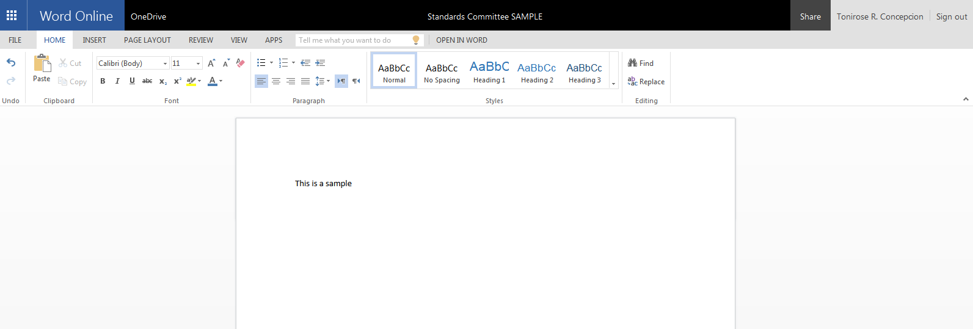

Slide 16
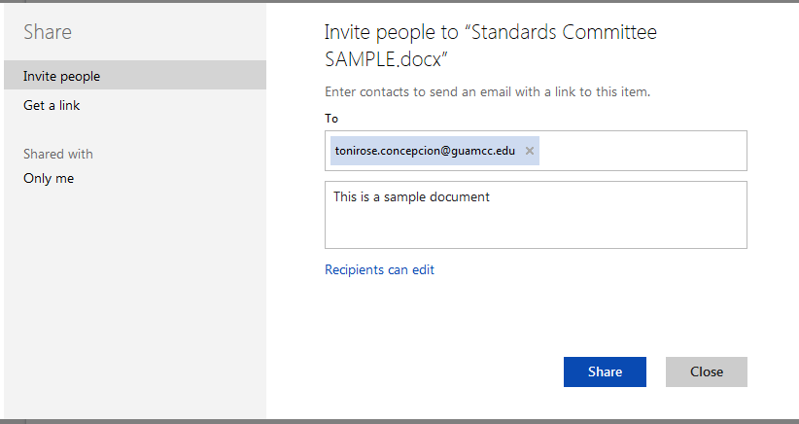

Slide 17
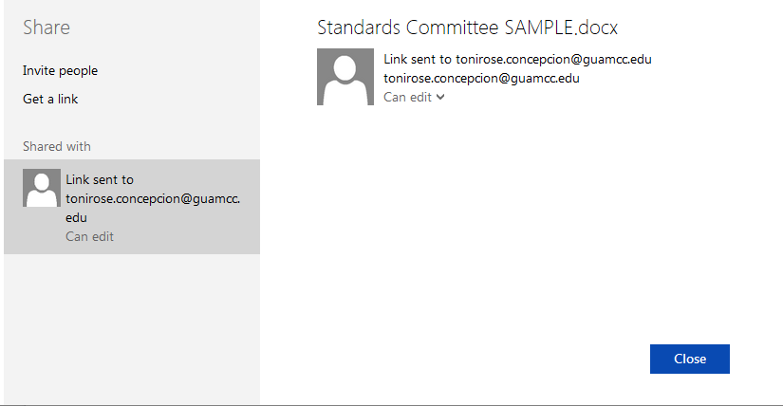

Slide 18
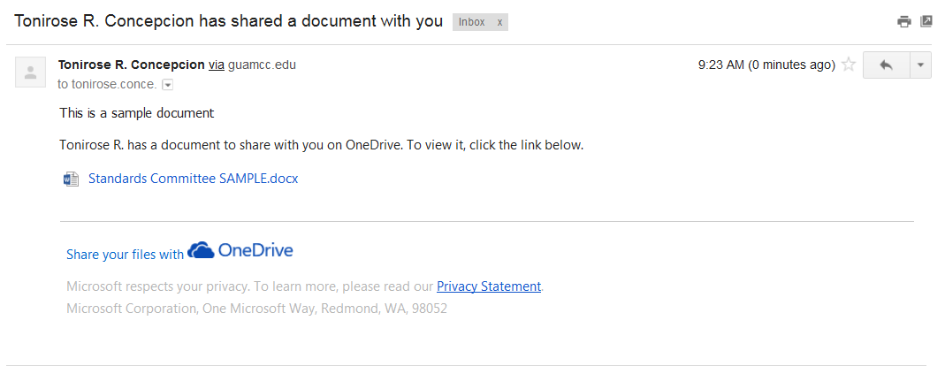

Slide 20
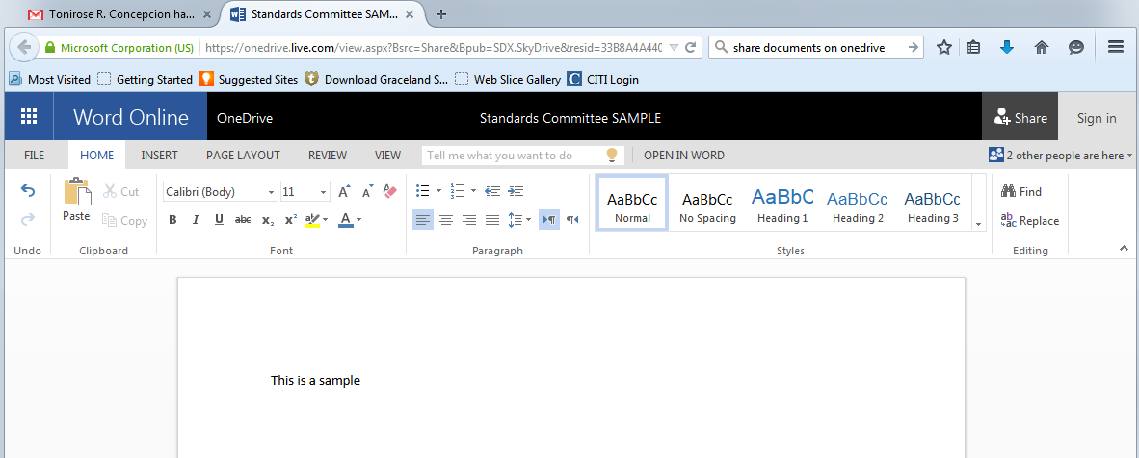

Slide 21
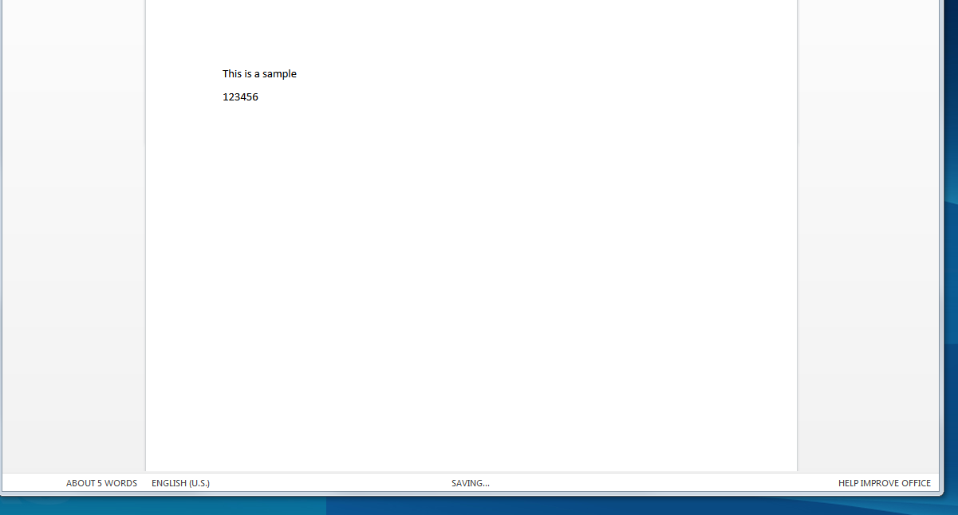

Slide 22
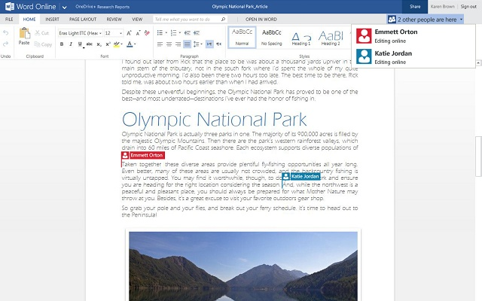

Slide 23
Thank you from …..

